Slide 1
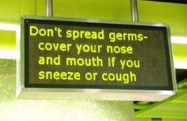
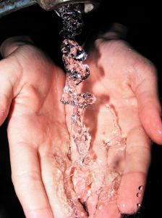
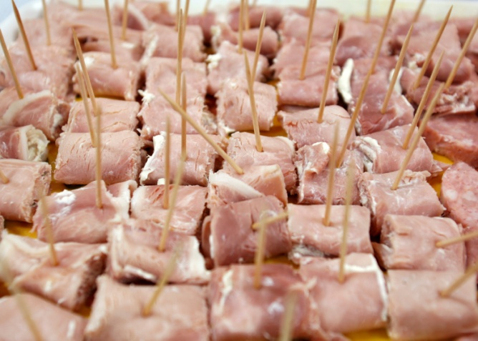
Apply standard safety procedures for handling foodstuffs
D1.HRS.CL1.02
Notes:
Trainer welcomes trainees to class.

Slide 2

Apply standard safety procedures for handling foodstuffs
This Unit comprises four Elements:
Identify hazards and risks
Follow enterprise hygiene standards, procedures and practices
Handle and store foodstuffs
Follow food safety program
Notes:
Trainer advises trainees this Unit comprises four Elements, as listed on the slide explaining:
• Each Element comprises a number of Performance Criteria which will be identified throughout the class and explained in detail
• Trainees can obtain more detail from their Trainee Manual
• At times the course presents advice and information about various protocols but where their workplace requirements differ to what is presented, the workplace practices and standards, as well as policies and procedures must be observed.

Slide 3

Assessment
Assessment for this unit may include:
Oral questions
Written questions
Work projects
Workplace observation of practical skills
Practical exercises
Formal report from employer/supervisor
Notes:
Trainer advises trainees that assessment for this Unit may take several forms, all of which are aimed at verifying they have achieved competency for the Unit as required.
Trainer indicates to trainees the methods of assessment that will be applied to them for this Unit.

Slide 4
Identify hazards and risks
Performance Criteria for this Element are:
Identify key hazards and risks associated with individual work role
Check own work area to identify hazards and risks
Notes:
Trainer identifies for trainees the Performance Criteria for this Element, as listed on the slide.
Class Activity – General Discussion
Trainer leads a general class discussion on identifying workplace food safety hazards and risks by asking questions such as:
Why is it important o maintain food safety in the workplace?
What issues might or food safety?
What are examples of things which could contaminate food?
How might food become contaminated?
What are the possible results of people being poisoned by food?

Slide 5

Identify key hazards and risks
Ways to identify food risks and hazards:
Personal observation
Personal experience
Analysis of food safety records
Regular workplace inspections
Notes:
Trainer states identifying workplace food safety hazards and risks is a critical element in applying safe food handling practices as identification of the problem is necessary to allow problems to be addressed advising the standard ways to identify key food safety hazards and risks in the workplace are:
Personal observation – of:
Workplace practice
Foodstuff
Equipment
Compliance with safe food handling practices and established, internal requirements
As a result of personal experience with items and situations – you will gain increasing knowledge as you work with food which will help you identify issues and analyse situations
Analysis of food safety records, documents and logs – which can reveal issues such as:
Refrigeration and freezers operating at incorrect temperatures
Food holding and display equipment operating at incorrect temperatures
Equipment and areas requiring attention or repair
Staff who are ill and who should be excluded from food handling duties
Conducting regular and scheduled workplace inspections and checks (audits) – to identify problem situations.
Class Activity – Handouts
Trainer distributes and discusses sample workplace food safety inspection checklists/audits.

Slide 6
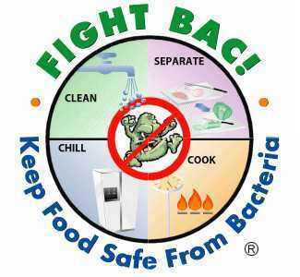
Identify key hazards and risks
Hazards and risks can occur at any food handling stage and may be in the form of:
Microbiological contamination
Chemical contamination
Physical contamination
Notes:
Trainer advises trainees in relation to hazards and risks explaining:
Hazards and risks can occur at any stage in the food handling process.
A hazard may be seen as something which actually exists and is likely to cause/result in harm.
A risk may be seen as:
Something likely to occur which would cause harm
The potential for harm or injury to occur when a hazard occurs.
For practical purposes the two terms can be used interchangeably.

Slide 7

Identify key hazards and risks
Microbiological contamination may be caused by:
Bacteria
Moulds
Yeasts
Viruses
Notes:
Trainer advises microbiological contamination is caused by bacteria, moulds, yeasts and viruses via intoxication or infection informing students problem bacteria include:
Clostridium perfringens – usually caused when food is cooked, chilled overnight and re-heated, or found in foods that are cooked 'rare'. The initial source of the contamination is faeces (man, birds, animal or insects) which is introduced somewhere along the food chain/production line (failure of staff to wash their hands after the toilet; flies carrying it onto food; contamination at the abattoir)
Salmonella – a very common contaminant. Faecal contamination is a prime source (failure to wash hands after the toilet; flies carrying it onto foods; leaky plumbing; fish harvested from waters polluted by sewage).
Streptococci – caused by nasal or oral discharges into food (coughing, sneezing), either directly or via hands that have been so contaminated.
Staphylococcus aureus – rapidly-acting bacteria where the main source is the food handler: nose, throat, mouth, skin, pimples and cuts.
Contamination may occur directly (coughing or sneezing onto food) or indirectly (coughing/sneezing into hands and then using the hands to handle food).
Clostridium botulinum – a rare bacteria but a very lethal contaminant (65% mortality rate). Can occur when heat processing of tins and jars is incomplete allowing spores (see below) to survive and cause the problem. Any tin that 'spurts' when opened, is leaky or is 'blown', or jars with broken seals must be discarded as this is a sign of botulism contamination: there is no adverse smell and food must not be tasted to test it as the small amount ingested during tasting can kill.
Note there is usually no sign food has been infected by bacteria.

Slide 8
Identify key hazards and risks
High risk food handling situations that may involve microbiological contamination:
Working with high risk foods
Working with food in Temperature Danger Zone
Displaying food
Processing food
Thawing and reheating of food
Notes:
Trainer states high risk food handling situations that may involve microbiological contamination include:
Working with any high risk/potentially hazardous foods
Working in temperatures that promote rapid bacterial growth
Displays of food and buffets – where the temperature may be compromised (hot food may fall below 60°C, cold food may rise above 5°C), plus there is always the danger members of the public – untrained in correct food handling procedures – may contaminate the food
Processing the food where it is touched by the bare hand and not subsequently cooked
Any situation requiring thawing and re-heating of high risk food always poses a risk the food may stay in the Temperature Danger Zone too long.

Slide 9

Identify key hazards and risks
Chemical contamination can be caused by:
Chemicals used on food when it is grown or processed
Chemicals inadvertently introduced to food
Over usage of fertilizers and pesticides by farmers
Contaminated food by radioactive particles
Naturally occurring poisonous food
Notes:
Trainer informs students chemical contamination can include contamination caused by chemicals:
Used on the food to produce and/or process it
Which find their way inadvertently into the food due to careless handling – for example:
Fly spray sprayed into the air and landing on food
Using a jug/container to measure chemicals and then using the same jug (without washing and sanitizing) to mix a sauce which is poured over food.
Specific and identified measuring vessels should always be allocated for chemicals – staff must not be allowed to use food service items to obtain, measure or pour any chemical. All chemicals must be stored away from food areas at all times.
Naturally occurring poisonous food are also classified as part of the ‘chemical contamination’ threat. Be aware of the following:
Mushrooms – certain fungi can be poisonous but those purchased from reputable suppliers should be safe: do not buy mushrooms from people calling door-to-door, and do not use in a commercial setting, mushrooms picked by private individuals
Rhubarb leaves are poisonous so great care should be given when stemming them
Green and sprouting potatoes contain a substance called 'solanine' which has been linked with food poisoning outbreaks so green potatoes should be discarded, returned to the supplier or rejected on delivery.

Slide 10

Identify key hazards and risks
Physical contamination can occur:
Before food arrives at the venue
During storage, preparation, service or other procedures
Constant vigilance is required to identify physical contaminants.
Notes:
Trainer tells students all food handlers must be on their guard to ensure foreign objects do not find their way into food for human consumption, remembering the foreign object may have found its way into the food before the product/item arrived at the premises.
Students must be constantly on the lookout for physical contaminants.
Class Activity – Question/Discussion
Trainer asks students to identify possible physical contaminants.
Possible answers include:
Hair from the head or beard
Metal filings left by can openers
Flies and insects – and their droppings
Bits of equipment and utensils which break off during the food preparation process and become incorporated into the food
Bits of glass.

Slide 11
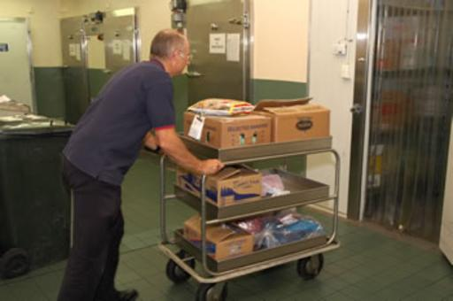
Identify key hazards and risks
You only have direct responsibility for the food handling duties you are employed to perform – for example:
Purchasing and receiving food
Storing food
Thawing frozen food
Food preparation activities
Cooking food
(Continued)
Notes:
Trainer informs trainees in practice they will have direct responsibility for the position/work role they are employed in and these specific responsibilities will be explained to them as part of their Induction and Orientation, and as part of the formal on-the-job training provided by the employer.
Examples may include responsibilities for:
Purchasing and receiving goods delivered into the premises by suppliers
Dry, cold and frozen storage of food which has been delivered
Thawing of frozen food
Food preparation activities (washing, peeling, chopping, mixing, weighing) food
Cooking food ready for immediate consumption and cooling food which has been cooked so it can be refrigerated or frozen for later use.

Slide 12
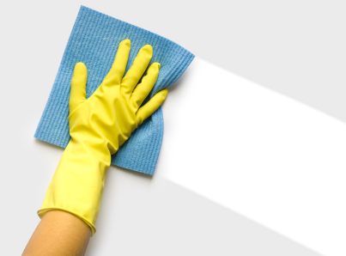
Identify key hazards and risks
Holding of food
Reheating previously cooked food
Displaying food
Supervising self-serve situations
Serving food
Cleaning
Notes:
Trainer continues providing examples of the food handling work students may have direct responsibilities for:
Cold holding and hot holding of prepared food so it can be kept ready for sale or service
Re-heating of prepared food where previously prepared food (or left-over food) is safely heated up for service
Displaying hot and cold food for service to customers
Supervising the self-service of food by customers to themselves
Serving food which may packaging food for take-away consumption or plating food for eat-in consumption
Cleaning food equipment, utensils, work areas and food contact surfaces.
Class Activity – Guest Speaker
Trainer arranges for local health authority to visit and talk to students about:
Obligations/requirements imposed on food handlers by legislation
Safe food handling techniques
Support available to assist with maintaining a safe and hygienic workplace.

Slide 13
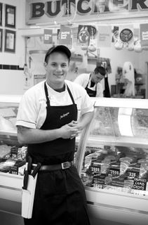
Identify key hazards and risks
At work you will also be expected to:
Participate in establishment-wide food safety training activities
Increased awareness for identifying hazards
Constant vigilance
Due diligence
Assist other staff in their food handling and food safety activities
Seek advice when unsure about what to do
Effective responses
Notes:
Trainer indicates students are also expected to:
Participate in establishment-wide food safety training activities
Increased awareness for identifying hazards
Constant vigilance
Due diligence
Assist other staff in their food handling and food safety activities
Seek advice when unsure about what to do
Effective responses

Slide 14
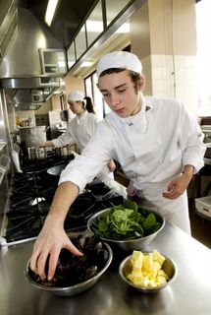
Check own work area
Checking your own work area can involve:
Inspecting work station prior to starting work
Adhering to workplace checklists
Monitoring work activities
(Continued)
Notes:
Trainer stresses need for students to check their own work area to identify hazards and risks indicating this can involve:
Inspecting the work area prior to commencing work:
Food areas, equipment and utensils are clean
No evidence of pests/vermin
Temperatures of refrigerators, cool rooms and freezers are correct
Deliveries have been inspected and stored appropriately and promptly
Following the requirements of any workplace-specific checklists which may be provided to guide inspections and checking procedures
Monitoring work on an ongoing basis – to ensure:
Required SOPs and work practices and protocols are being implemented
Food safety is being maintained
Equipment is operating correctly
Required temperatures (for processing and holding and display) are being maintained
Required cooking times for food is being achieved
Cleaning and sanitizing of food equipment is occurring in between uses
Cleaning of food areas and food contact surfaces is occurring at least every four hours
Spills are cleaned up as they occur
Rubbish is being removed regularly
Personal hygiene requirements are being consistently implemented.

Slide 15
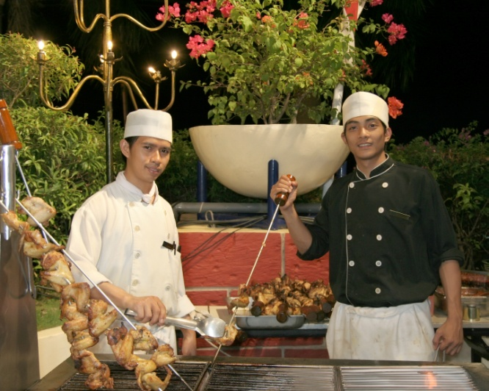
Check own work area
Verifying safety of food to be used
Observing what colleagues do
Testing equipment
Notes:
Trainer continues providing advice as to how students may check their work areas:
Verifying safety of food to be used:
Inspecting for signs/evidence of contamination
Checking use-by date
Ensuring packaging has not been compromised
Observing food handling practices of colleagues – to ensure they also handle food safely and hygienically
Testing equipment – to make sure it is operating correctly.
Class Activity – Guest Speaker
Trainer arranges for management-level person in a local food handling venue to attend and talk to students about:
Their expectations and requirements regarding activities of food handling
Examples of in-house food safety training
Examples of SOPs to enable/support safe food handling
Requirements of Food safety Plan.
Documents used to monitor and record safe food handling practices.

Slide 16
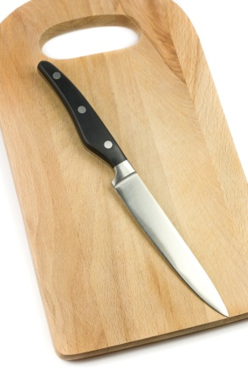
Check own work area
Be alert to potential for:
Food contaminated by vermin
Contaminated items
Dirty equipment and utensils
Garbage
(Continued)
Notes:
Trainer stresses the need for constant vigilance by all food handlers and presents additional hazards/situations they need to be aware of:
Food contaminated by vermin – through urine, faeces, gnawing, their presence in it
Airborne dust – either due to natural causes (dust storms, weather) or due to internal causes (renovations)
Contaminated items – such as linen, tea towels contaminated with human waste such as blood, secretions (sweat) or food
Dirty equipment and utensils – which can include:
Items not properly cleaned and sanitized after use
Items dropped on the floor
Items contaminated by clothing, coughing/sneezing, or cross contamination of any sort
Garbage – all garbage presents a potential hazard whether it is stored in bins inside the premises or in containers outside the premises: remember hands must be washed after handing garbage and all garbage containers must be kept clean when not in use.

Slide 17
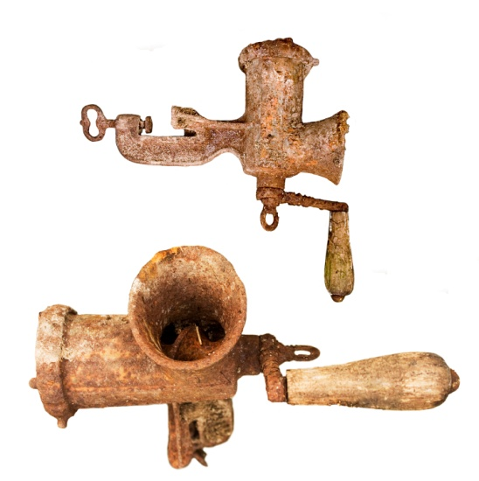
Check own work area
Out-of-date food handling practices
Colleagues who require training
Equipment not operating as intended
Notes:
Trainer continues to present additional hazards/situations they need to be aware of:
Out-of-date food handling practices – hazards can occur where:
The nature of the food operations being undertaken have changed
The food equipment being used has altered
The food items being processed have changed and there is no subsequent and appropriate alteration to the previously existing food handling protocols
Colleagues who require training – even where staff have undertaken an approved food safety course there is no guarantee they will apply, in the workplace, the lessons they have learned: where workers are using incorrect food service practices and/or failing to observe other safe food handling principles (especially in relation to personal hygiene, hand washing) there is a need for re-training
Equipment not operating as intended – this typically includes all food processing and holding equipment (especially refrigerators/cool rooms, freezers, food warmers and bain maries) as well as food thermometers.

Slide 18
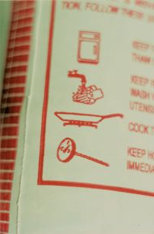
Check own work area
Keys in responding to threats (hazards and risks):
Awareness
Constant vigilance
Quick and effective response
Record in log book
Immediate reporting
Notes:
Trainer explains appropriate action to take in response to situations will depend on the hazard identified and more detailed responses are provided on later slides but at this stage it is important to realise keys in responding to these threats are:
Awareness – of what causes problems and poses hazards and risk: which is why safe food handling training is important
Constant vigilance – of what is happening (or not happening) in the workplace
Quick and effective responses – where you are able to act effectively in accordance with the scope of authority for your job
Record in log book – follow organisational procedures
Immediate reporting – to (for example) supervisor, chef, manager or owner where you identify non-compliance with safe food handling requirements and any out-of-control situations.

Slide 19
Summary – Element 1
When identifying hazards and risks:
Use personal observation
Gain experience to help provide a basis for analysing what is occurring
Read workplace food safety records to determine what is happening
(Continued)
Notes:
Trainer provides a recap of the Element asking questions to check trainee understanding and responding to questions from trainees, as required.

Slide 20
Summary – Element 1
Undertake regular and required workplace inspections and checks
Be alert to the potential for microbiological, chemical and physical contamination
Pay special attention to high risk food handling situations
(Continued)
Notes:
Trainer provides a recap of the Element asking questions to check trainee understanding and responding to questions from trainees, as required.

Slide 21
Summary – Element 1
Focus on the food handling area and activities for which you have direct responsibility
Be prepared to assist in venue-wide safe food handling initiatives and requirements
Ask for help, advice and direction when not sure about what to do
(Continued)
Notes:
Trainer provides a recap of the Element asking questions to check trainee understanding and responding to questions from trainees, as required.

Slide 22
Summary – Element 1
Apply checking procedures to verify safe food handling protocols are being applied
Protect food from contamination
Take appropriate remedial action where necessary
Report instances of non-compliance and out-of-control situations
Notes:
Trainer provides a recap of the Element asking questions to check trainee understanding and responding to questions from trainees, as required.

Slide 23
Follow enterprise hygiene standards, procedures and practices
Performance Criteria for this Element are:
Implement required personal hygiene practices
Maintain clothing to meet work area standards
Follow hygiene procedures in accordance with enterprise requirements
Notes:
Trainer identifies for trainees the Performance Criteria for this Element, as listed on the slide.
Class Activity – Discussion
Trainer asks trainees questions about following enterprise food hygiene standards, procedures & practices by asking questions such as:
What do you might be workplace food safety standards, procedures and practices?
Why have they been developed?
What are examples of standard/required personal hygiene practices for food handlers?
Why is it important to adhere to them?
How do you learn what they are?
What happens if you do not follow them?

Slide 24
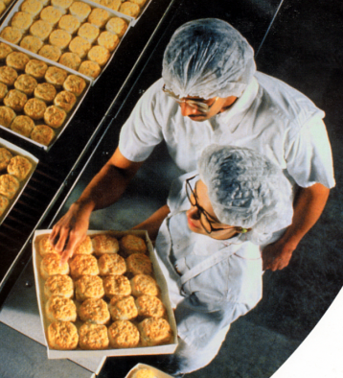
Implement required personal hygiene practices
Necessary personal hygiene practices for food handlers:
Have a shower before work
Wash hands using the standard procedure
Avoid touching cooked or ready-to-eat food with bare hands
Avoid touching food surfaces with bare hands
Do not wear jewellery on hands or wrists
No wearing of wrist watch on duty
Control facial hair
(Continued)
Notes:
Trainer introduces and explains the importance of personal hygiene presenting personal hygiene practices which minimise the possibility of food contamination:
Have a shower before work
Wash hands using the standard procedure
Avoid touching cooked and/or ready-to-eat food with the bare hands – use tongs, a spatula, fork, serving spoon or gloves
Avoid touching food surfaces with the bare hands – this means avoiding touching preparation benches, preparation equipment and the food contact surfaces of serving items (plates, cutlery, glasses, cups)
No jewellery to be worn on hands and wrists – food can lodge in the jewellery, deteriorate and then fall back into food.
There is also a chance stones/gems may fall out into the food providing a physical food contaminant.
If you must wear a ring then cover it using a coloured band-aid and glove
No wearing of wrist watch on duty
Facial hair must be kept neat and controlled – hair should either be covered or sprayed to keep it controlled in such a way that hairs do not fall into food.
Long hair must be tied back (this is applicable to waiting staff as well as food preparation and food service staff), and beards should also be covered with a snood. In kitchens, hair nets or hats should be worn.
Class Activity – Presentation and Demonstration
Trainer shows students examples of:
Tongs
Spatula
Service fork
Serving spoon
Disposable gloves
Hair net/cap
Beard snood
Trainer demonstrates correct procedure for:
Controlling hair
Wearing hair net/cap and beard snood.

Slide 25
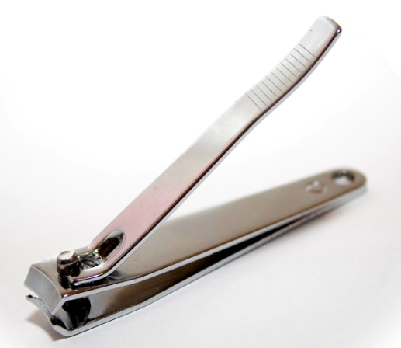
Implement required personal hygiene practices
Have short, clean fingernails
Wear clean clothes
No smoking or betel in food areas
Stay away from work when ill
(Continued)
Notes:
Trainer continues presenting personal hygiene requirements for food handlers:
Fingernails must be short, clean and free of polish (including clear nail polish) – cracked fingernails and chipped nail polish can harbour bacteria and may also flake off into food.
Fingernail decorations and artificial nails are also prohibited
Clothing must be clean – a minimum requirement is for clean clothes for each shift with further changes as spillages and 'working dirt' dictate.
It is not permitted to wear ‘food handling’ clothes to and from work.
Refraining from smoking or chewing tobacco or betel in any food area – it is also a good idea to put up ‘No Smoking’ posters and to remove ash trays from these areas
Staying away from work when suffering cold or flu symptoms – and obtaining a doctor’s certificate stating that as a food handler it is safe to return to work.

Slide 26
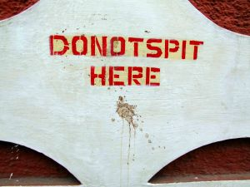
Implement required personal hygiene practices
Doctor’s certificate required to return to work after suffering a communicable disease
No spitting in food areas
Do not taste food with spoon and replace spoon into food
Consider wearing a sweat band
(Continued)
Notes:
Trainer continues presenting personal hygiene requirements for food handlers:
Food handlers with any communicable disease must not deal with food until they receive a certificate from a doctor stating as a food handler they are cleared to work with food
Refraining from spitting in any food area
Avoiding tasting of food with a spoon and then returning the utensil to the food
Wearing a sweat band – or mopping areas that sweat and then thoroughly washing hands (to prevent sweat falling into food).

Slide 27
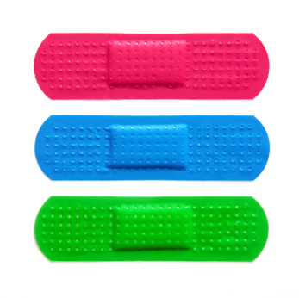
Implement required personal hygiene practices
Cover cuts and sores on hands and fingers
Do not blow into a bag with your breath (to open the bag)
Do not lick your fingers to separate wrapping paper for food
Do not touch any body opening
Wash hands properly when required
Notes:
Trainer continues presenting personal hygiene requirements for food handlers:
Covering all cuts and sores on hands and fingers with approved (coloured) waterproof dressings and bandages – and adding a finger stall and/or disposable glove, as appropriate
Not blowing with the breath into a bag to be used to wrap food
Not wetting fingers to assist with separating sheets of wrapping paper when packaging take away foods
Not touching any body opening – such as ears, eyes, nose: thorough hand washing must occur if this happens
Hands must be washed properly – and washed when required (more information and demonstration on later slides).

Slide 28

Implement required personal hygiene practices
Eating food in food preparation areas:
Do not eat food over or above unprotected surfaces
Do not eat food over or above unprotected food
House policies may ban eating food in food prep areas
House policies may ban all people eating food over or above unprotected surfaces or food
Notes:
Trainer talks about food handlers eating food in food preparation areas stating there is no law forbidding staff from eating in food areas but they must:
Not eat any food over an unprotected food surface – such as food preparation equipment, preparation benches, serving equipment or crockery, cutlery or glassware
Not eat any food over any unprotected food – this applies to raw food, ready-to-eat food or any food that is not covered, wrapped or packaged so that it cannot become contaminated through food falling onto it
Note individual premises may have house policies forbidding the consumption of food while working.
Note also the above requirements in relation to eating over unprotected food and unprotected food surfaces applies to anyone on the premises – including members of the public, customers and visitors.

Slide 29

Implement required personal hygiene practices
Action to take:
If a food surface is known or suspected of being contaminated it must be cleaned and sanitised
If food is known or suspected of being contaminated it must be thrown out
Notes:
Trainer identifies action to take such as:
Where it is known or suspected a food surface has been contaminated by coughing, sneezing or any other unsafe practice (such as anything giving rise to cross contamination) the surface must be cleaned and sanitized before being used/re-used.
Where it is known or suspected unprotected food has been contaminated by coughing, sneezing or any other unsafe practice (such as anything giving rise to cross contamination) it must be discarded.
Any food that is known to be contaminated, or suspected of being contaminated, must be disposed of as garbage – it must not be given away to customers, staff or any organization.

Slide 30
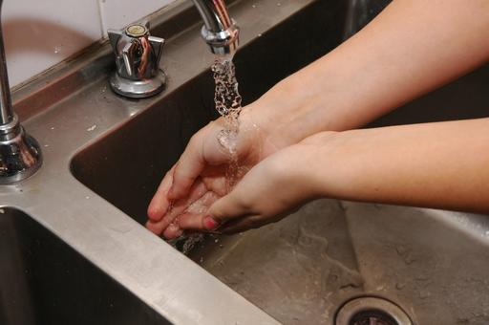
Implement required personal hygiene practices
Food handlers must wash hands:
Any time they may be a source of contamination:
After handling garbage, animals or money
After undertaking cleaning duties
After taking delivery of food
In between handling raw and cooked or ready-to-eat food
(Continued)
Notes:
Trainer highlights the importance of food handlers washing their hands properly stating they must wash their hands:
Any time the hands are likely to be a source of contamination – this can cover a wide range of possible circumstances and it is impossible to identify them all but the following is a representative list:
After handling rubbish/garbage and before handling food or food contact surfaces
After undertaking cleaning duties and before handling food or food contact surfaces
After handling animals and before handling food or food contact surfaces
After changing a baby’s nappy and before handling food or food contact surfaces
After accepting a delivery of food into the premises and before handling food or food contact surfaces
After handling money and before handling food or food contact surfaces
In between handling raw high risk food (meat, fish or chicken) and handling other foods such as cooked and/or ready-to-eat food.

Slide 31
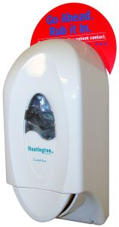
Implement required personal hygiene practices
Before they start work
Immediately after:
Smoking
Coughing or sneezing
Using handkerchief or tissue
Eating or drinking
Touching the body
(Continued)
Notes:
Trainer continues to identify when food handlers need to wash their hands:
Before they start their food handling duties – this means food handling staff must wash their hands when they arrive at work even though they may have showered, bathed or washed their hands at home before coming to work
Immediately after engaging in nominated activities which have proved to be associated with bacterial transfer/cross contamination. The nominated activities include:
Smoking – including using tobacco products
Coughing or sneezing
Using a handkerchief or nasal tissue – which includes blowing the nose
Eating or drinking
Touching hair, scalp, mouth, nose, ears, any body opening or any wound.

Slide 32
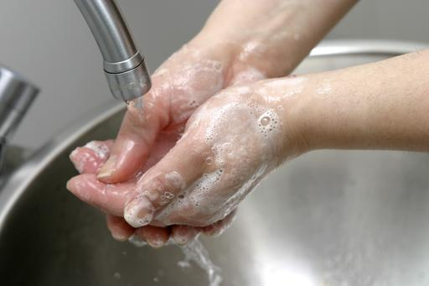
Implement required personal hygiene practices
After any ‘absence from the workstation’ – for example:
Taking a delivery
Answering the telephone
Undertaking any work which is not food handling
After using the toilet
Notes:
Trainer continues to identify when food handlers need to wash their hands:
After any absence from the work station – this means every time a food handler leaves the kitchen (or other place where they are handling food) they must wash their hands on their return to work and before they handle food. These absences from the work station may involve or be caused by:
Leaving the kitchen to accept a delivery of food
Taking a phone call
Undertaking any work which is not related to food handling
Immediately after using the toilet and before handling food or food contact surfaces – this applies to all instances where the toilet was used and includes a requirement to wash hands after urination as well as after defecation.

Slide 33

Implement required personal hygiene practices
Regulations regarding hand washing facilities:
Must be supplied with hot water and soap
Should have a nail brush
Sinks or basins for hand washing must not be used for food
Food sinks must not be used for hand washing
Should be an adequate size
Must have proper hand drying facilities
Have a waste bin provided
Notes:
Trainer explains requirements regarding provision of hand washing facilities:
Be supplied with a continuous supply of warm running, potable water – the accepted temperature of this water is 40ºC
Be supplied with soap – most premises use bulk soap dispensers dispensing liquid anti-bacterial soap.
The use of bars of soap is to be avoided as the soap can transfer bacteria
Only be used for washing hands, arms and face – the wash hand basins must not be used for other purposes such as food preparation or as a ‘slop’ sink.
Signage must indicate these wash hand basins are for the sole purpose of hand washing.
Sinks in the kitchen/food preparation area used for other purposes (washing food; cleaning pots and pans) must not be used for hand washing.
Be of an appropriate size to enable the effective washing of hands
Be supplied with appropriate means of drying the hands – this can be single use (paper) towels and hot air dryers
It is not acceptable for a business to provide only a hot air dryer.
Re-usable towels can be used provided they are washed and dried after every use – this is extremely unlikely to happen in most businesses so the preferred option is to use paper/disposable towel.
Be supplied with a bin – for disposing of used disposable towels.
A nail brush should also be supplied so cleaning under the fingernails can occur.

Slide 34
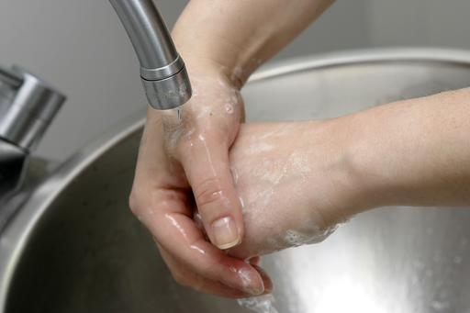
Implement required personal hygiene practices
Procedure for hand washing:
Rinse off visible dirt
Apply soap
Wash for 20 seconds
Rinse
Dry
Notes:
Trainer explains hand washing requirements are food handlers ‘thoroughly clean’ their hands, meaning they must:
Rinse off visible and easy to remove dirt
Apply soap/detergent
Wash hands for at least 20 seconds:
Thoroughly and vigorously massage the soap into the folds and creases of the hands and wrists
Clean under the fingernails
Rinse soap from hands
Thoroughly dry hands – the preferred method of drying hands is to:
Shake off excess water
Dry with paper towel
Finish with hot air dryer.
Class Activity 1 – Demonstration and Practical
Trainer demonstrates correct procedure for food handlers to wash and dry their hands and provides opportunity for students to practice same.
Class Activity 2 – Use of UV light kit (demonstration)
Trainer uses UV light kit to demonstrate the need for proper hand washing (following instructions provided in the kit.

Slide 35
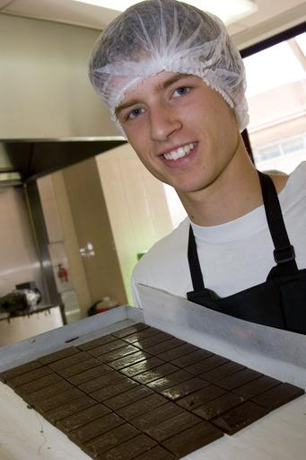
Maintain clothing
Clothing requirements for food handlers:
Must be clean
Does not provide a source of contamination
Must be changed when dirty
Protective clothing must be removed before visiting the toilet
(Continued)
Notes:
Trainer explains food establishments may require staff to wear a nominated uniform or other personal protective equipment or clothing highlighting the following requirements apply:
Uniform and protective clothing and equipment worn/used by food handlers must be clean – dirty clothing may directly or indirectly contaminate food and/or food preparation equipment or surfaces
Food handlers are legally obliged to ensure their clothing does not contaminate food or food-related equipment, utensils or surfaces
Clothing that becomes dirty and a risk to food must be changed – you should take into account the nature of the work being performed when making a judgement about the state of your clothes.
For example, a cook dealing with raw meat and blood can be expected to have dirtier clothes than a counter-hand making sandwiches or serving prepared food
Outer clothing needs to be changed when it has become soiled as a result of handling exposed (that is, not packaged) high risk raw food and there is then a need to handle exposed ready-to-eat food
Protective clothing such as aprons, overalls, hats, gloves and other outer protective clothing/equipment should be removed before visiting the toilet.

Slide 36
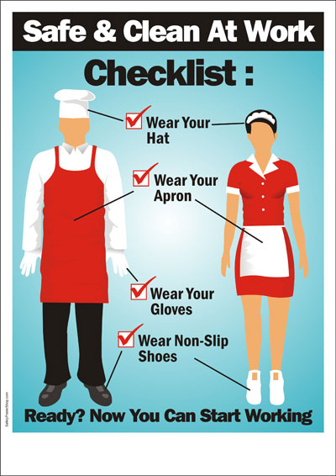
Maintain clothing
Avoid loose-fitting clothes
Wear clean clothes daily
Have a change of clothes at work
Do not wear food handling clothes when going to and from work
(Continued)
Notes:
Trainer continues providing requirements for food handler clothing:
Avoid loose-fitting clothes – they increase chance of clothing dragging into food and posing a contamination threat
Wear clean clothes to work daily
Have a change of clothes available at work
Do not wear food handling clothes to and from work.

Slide 37
Maintain clothing
Wear an apron
Make sure buttons are not loose
Fasten brooches and name tags securely
No rings or watches
(Continued)
Notes:
Trainer continues providing requirements for food handler clothing:
Wear protective clothing such as aprons.
Ensure buttons on food handling clothes are not loose – or they may fall off and drop into food presenting a physical hazard
Avoid adding brooches, name tags, clips, pins to clothes – unless they are securely fastened and unable to fall off
Avoid rings and watches on hands and wrists.
Even plain, banded rings can cause a potential food poisoning source and gloves should be when handling food if these are worn.

Slide 38
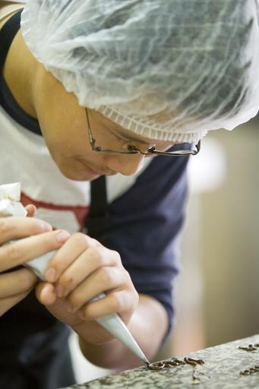
Maintain clothing
No ear-rings
Avoid fiddling with jewellery
No hair clips or hair pins
Wear a hair net or hat
Notes:
Trainer continues providing requirements for food handler clothing:
Do not wear ear-rings – ear-rings that dangle are the worst but not wearing them at all is preferable.
Sleepers may be acceptable in some venues but check house rules first
Avoid fiddling/playing with jewellery – especially ear-rings in pierced ears
Avoiding wearing hair clips
Avoiding using hair pins
Ensuring anything worn in the hair is securely fastened in place
Wearing a hair net or hat to guard against items falling out of the hair and into food or into food preparation equipment or onto food preparation surfaces.

Slide 39
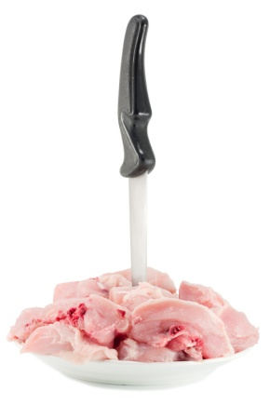
Follow hygiene procedures
Cross contamination:
Bacteria depend on humans to transfer them from place to place
Transfer can occur through:
Direct contact
Indirect contact
Notes:
Trainer introduces concept of cross contamination.
All food handlers must be aware of the concept of cross contamination.
Cross contamination is the contamination of food (or food preparation surfaces, equipment etc) with bacteria, chemicals or allergens as a result of contact with a contaminated source.
Bacteria cannot fly, jump or hop so they depend on people to move them around from place to place via direct contact or through indirect contact
Cross contamination may occur via direct or indirect contact:
Direct contact
Using a knife to cut raw meat and then using the same knife to cut cooked, ready-to-eat meat without cleaning and sanitizing the knife in between tasks – the blood and residual meat on the knife will carry bacteria and this will be transferred by the knife to the previously safe cooked, ready-to-eat meat
Using a chopping board to cut raw chicken and then using the same chopping board to cut cooked meat for salads without cleaning and sanitizing the board in between tasks – the chopping board will carry bacteria from the uncooked chicken (the cooking process should destroy the bacteria) which will then be transferred to the previously safe to eat cooked meat
Indirect contact
As previously explained this involved coughing or sneezing into a hand and then using that hand to prepare/touch food or to touch a food preparation surface.

Slide 40
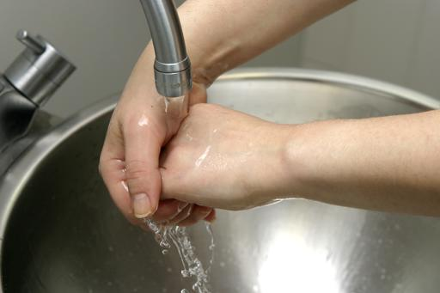
Follow hygiene procedures
Practices to prevent cross contamination:
Clean and disinfect food preparation areas and equipment
Careful avoidance of meat contaminated with salmonella and pathogens
Extreme care in preparing raw food
Institutional dish sanitizing with soap and clean water
Washing of hands thoroughly before touching food
Notes:
Trainer presents a range of techniques/practices used in the workplace to help food handlers prevent cross contamination.
Trainer to discuss importance of these points.

Slide 41
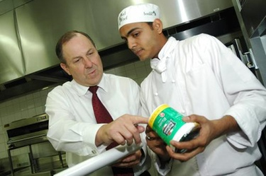
Follow hygiene procedures
Practices to prevent cross contamination:
Avoid using the same utensils for other food
Avoid using utensils that have been licked.
Observe proper storage of food
Practice appropriate refrigeration of food
Label food to indicate the life span of food
Proper disposal of uneaten food and packed or canned food stuff
Notes:
Trainer presents a range of techniques/practices used in the workplace to help food handlers prevent cross contamination.
Trainer to discuss importance of these points.

Slide 42
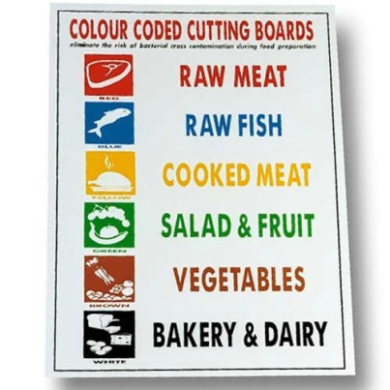
Follow hygiene procedures
Practices to prevent cross contamination:
Using different staff to handle raw food and cooked or ready-to-eat food
Washing and sanitizing items between uses
Using color-coded chopping boards
Implementing all personal hygiene protocols
(Continued)
Notes:
Trainer presents a range of techniques/practices used in the workplace to help food handlers prevent cross contamination:
Using separate staff to handle raw high risk food and other food that is cooked and/or ready-to-eat
Washing and sanitizing all preparation surfaces, equipment and utensils in between each use
Using colour-coded chopping boards
Ensuring proper personal hygiene practices are implemented.
Class Activity – Presentation
Trainer presents trainees with samples of:
Colour-coded chopping boards
Posters instructing use of different coloured boards for different foods – such as:
White – for dairy products only
Red – for raw meat only
Blue – for seafood only
Yellow – for poultry only
Brown – for cooked meat only
Green – for fruit and vegetables only.

Slide 43
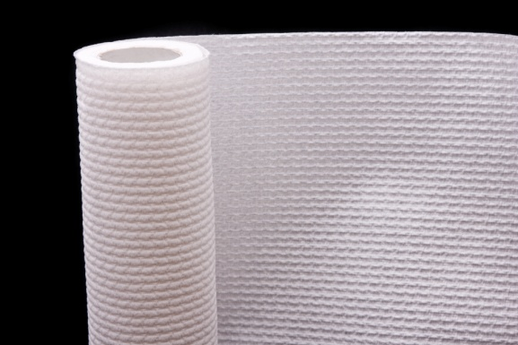
Follow hygiene procedures
Separating chemicals from food
Using clean containers for food storage
Using clean items for service of food
Using disposable paper towels
(Continued)
Notes:
Trainer continues presenting a range of techniques/practices used in the workplace to help food handlers prevent cross contamination:
Keeping chemicals away from food and food preparation/service areas – this includes eliminating the use of chemicals in food areas when food is present
Using cleaned and sanitized containers for every food preparation and storage requirement – this applies to all storage, preparation or display environments
Using only cleaned and sanitized crockery, cutlery and glassware for the service of food and drinks – this includes ensuring all service items are properly stored after cleaning to protect them from contamination
Using only disposable (paper) towels for wiping hands or cleaning up spills and immediately discard after use – do not use clothing (such as fronts of jackets, aprons) or cloth tea towels.

Slide 44
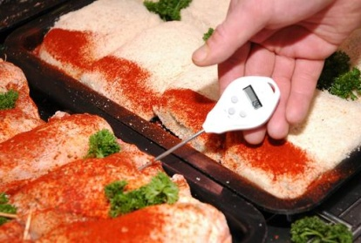
Follow hygiene procedures
Storing raw food below cooked or ready-to-eat food
Never storing food on the floor
Only using designated hand washing sinks for washing hands
Cleaning and sanitising food thermometers between uses
(Continued)
Notes:
Trainer continues presenting a range of techniques/practices used in the workplace to help food handlers prevent cross contamination:
Never storing raw high risk food above cooked and/or ready-to-eat food – to eliminate the risk posed by blood/juice dripping onto raw food below
Never storing food containers on the floor
Using hand wash sinks only for hand washing – and not using food preparation sinks for hand washing
Cleaning and sanitizing probe thermometers in between each use.
Class Activity – Demonstration
Trainer demonstrates how to clean and sanitize a probe thermometer using a sanitizing wipe.

Slide 45

Follow hygiene procedures
Cleaning low-risk areas before cleaning high-risk areas
Washing fruit and vegetables in sanitizing solution
Wearing clean clothes
Implementing requirements of cleaning schedules
(Continued)
Notes:
Trainer continues presenting a range of techniques/practices used in the workplace to help food handlers prevent cross contamination:
Cleaning low risk areas and equipment before cleaning high risk areas when the same cleaning items/equipment have to be used
Washing all fruit and vegetables, especially salad vegetables, in a sanitizing solution before use
Wearing clean clothes and clean protective clothing for each shift
Cleaning and sanitizing food equipment, utensils and preparation areas in accordance with the cleaning schedule for the premises – including the cleaning and sanitizing of preparation benches in between preparing raw high risk food and other foods.
Class Activity 1 – Demonstration
Trainer shows class how to wash fruit and vegetables in sanitizing solution prior to use.
Class Activity – Handout
Trainer distributes and discusses sample cleaning schedule.

Slide 46
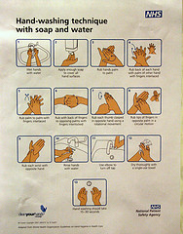
Follow hygiene procedures
Using waterproof bandages and colored band aids
Following correct hand washing protocols
Separating storage of raw and cooked or ready-to-eat foods
Covering foods
(Continued)
Notes:
Trainer continues presenting a range of techniques/practices used in the workplace to help food handlers prevent cross contamination:
Using waterproof bandages and dressings on cuts and sores
Washing – and properly drying – hands when and as required
Separating the storage of raw and cooked/ready-to-eat foods – by storing (for example) in different areas of the refrigerator and/or on separate trays
Keeping foods covered as much as possible when in storage, while being processed and displayed.
Class Activity – Presentation
Trainer distributes samples of:
Water proof bandages/dressings
Coloured band aids which should be used by food handlers.

Slide 47
Follow hygiene procedures
Using separate sinks for different food-related activities
Changing disposable gloves as required
Never mixing batches of food
Not replacing tasting spoons into food
(Continued)
Notes:
Trainer continues presenting a range of techniques/practices used in the workplace to help food handlers prevent cross contamination:
Using separate sinks for washing ready-to-eat salad vegetables/vegetables and other high risk foods – this includes a requirement a sink used for thawing high risk foods by running it under cold water should take place in a different sink to the one used for washing salad vegetables/vegetables
Changing disposable gloves whenever there would be a need to wash hands – such as in between handling raw high risk food and cooked/ready-to-eat food: gloves should be changed every hour regardless
Not mixing batches of food
Refraining from tasting food and replacing the spoon back in the pot.

Slide 48
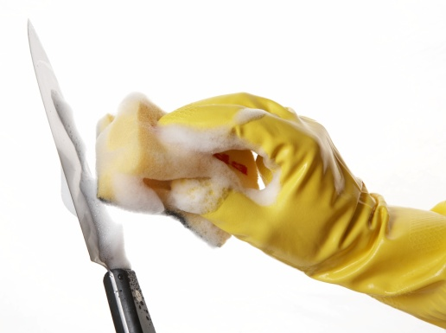
Follow hygiene procedures
Not coughing or sneezing over food and food surfaces
Cleaning and sanitizing knives in between use on raw and cooked or ready-to-eat foods
Cleaning and sanitizing prep benches every 4 hours
Separating kitchen cleaning equipment from items used to clean other areas
(Continued)
Notes:
Trainer continues presenting a range of techniques/practices used in the workplace to help food handlers prevent cross contamination:
Not coughing or sneezing over food or food preparation equipment, utensils or surfaces
Cleaning and sanitizing knives in between cutting raw high risk foods and cooked/ready-to-eat foods
Cleaning and sanitizing food preparation benches and equipment that are in constant use at least every four hours
Avoiding the use of the same cleaning equipment between other areas of the premises (such as bathrooms and bedrooms) and the kitchen.

Slide 49
Follow hygiene procedures
Making immediate repairs to food areas when required
Excluding pests, vermin and animals from food prep areas
Discarding food known to be, or suspected of being, contaminated
Excluding sick employees from food handling activities
Using workplace signage about preventing cross contamination
(Continued)
Notes:
Trainer continues presenting a range of techniques/practices used in the workplace to help food handlers prevent cross contamination:
Repairing cracked surfaces in the food preparation area
Excluding pests and implementing an effective pest control program – which may necessitate the use of a qualified professional external pest control company
Discarding all food that is known to be contaminated – or suspected of being contaminated
Excluding food handlers who are ill from food handling and food-related activities
Putting up signs/posters in the workplace to remind food handlers about cross contamination.
Class Activity – Small Group Exercise
Trainer asks trainees to prepare posters suitable for placement in the work area which:
Advise staff of personal hygiene requirements
Advise staff on safe food handling practices
Inform patrons at self-serve buffets regarding safe food handling practices to be implemented at the buffet.

Slide 50
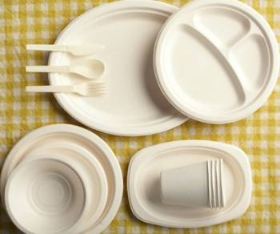

Follow hygiene procedures
Protecting displayed food from contamination
Discarding all food dropped on the floor
Throwing out food returned on plates
Not re-using single-use items once
Inspecting food delivery vehicles
Notes:
Trainer continues presenting a range of techniques/practices used in the workplace to help food handlers prevent cross contamination:
Displaying food so it is protected from contamination by customers – including the use of sneeze guards, monitoring patron actions where self-service food is available and taking appropriate action when the potential for cross contamination to have taken place has been identified
Disposing of any food dropped on the floor
Disposing of any food returned from a patron – this includes food and beverage items
Disposing of any single-use item which has been used once and/or has become contaminated (or is suspected of being contaminated) for any reason – more information on later slides
Inspecting food deliveries into the premises to ensure they are not contaminated by any visible sources.
Class Activity – Presentation
Trainer shows class examples/samples of single-use items.
Take-away food and drink containers
Drinking straws
Disposable gloves
Plastic cutlery
Food wrappers – around items such as hamburgers and other take-away menu items.

Slide 51
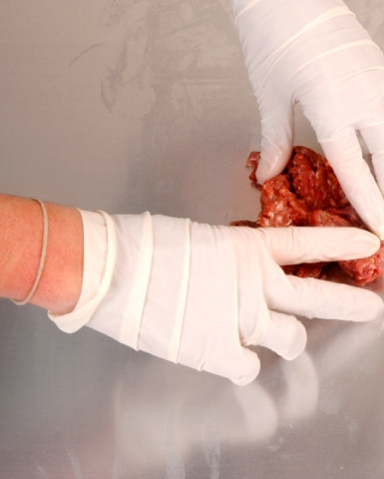
Follow hygiene procedures
Ways to prevent direct contact with ready-to-eat foods:
Wearing disposable gloves
Using utensils
Using paper
Notes:
Trainer informs students on practical measures to prevent direct contact with ready-to-eat foods:
Wearing disposable gloves – and changing them as required (see following slides)
Using utensils (tongs, spatulas, forks, spoons) instead of bare hands to handle ready-to-eat food
Using paper (tissue/packaging materials for take-away food) to act as a barrier between ready-to-eat foods and bare hands.
Class Activity – Demonstration
Trainer demonstrates the practices identified on the slide for preventing direct contact between hands and foods.

Slide 52
Follow hygiene procedures
Use disposable gloves when handling food:
Replace when torn
Change in between handling raw high-risk food and cooked or ready-to-eat food
Change every hour
Change if they are used to handle money
(Continued)
Notes:
Trainer instructs trainees on the use of disposable gloves by food handlers stating:
The use of protective, disposable gloves in food handling is an excellent safe food handling practice but gloves do not/can not fix all food hygiene problems and requirements relating to the use/wearing of disposable gloves include:
Change gloves immediately they are ripped/torn
Change gloves between handling raw high-risk food and cooked, ready-to-eat foods
Change gloves every hour regardless
If handling money do not use gloved hand to handle food.

Slide 53
Follow hygiene procedures
Do not remove over or above food
Do not re-use disposable gloves
Do not turn inside-out and wear again
Change whenever they become contaminated
Change gloves whenever you would have a need to wash hands
Notes:
Trainer continues to instruct trainees on the use of disposable gloves by food handlers:
If changing gloves during service ensure they are not taken off over food/food surfaces if the gloves contain powder as the powder may provide a source of contamination
Do not try to put on gloves that have already been used
Do not turn gloves inside out and try to wear them again
Change gloves whenever they become contaminated from whatever source – raw food, blood, sneezing, chemicals, scratching the face, handling rubbish
Whenever required to wash hands, gloves should be changed.

Slide 54

Follow hygiene procedures
Single-use items:
Must not be used more than once
Must be stored to protect against contamination
Must not be used if contaminated
Must be ‘clean’
Notes:
Trainer re-visits single-use items stating:
Must not be used more than once by the business – customers are free to re-use them at home as they see fit
Note single-use containers may, however, be used for non-food activities – such as collecting or storing dirty cutlery.
Must be stored and/or displayed so as to be protected from contamination – this contamination may be from:
Flies, pests and vermin
An infected food handler
Airborne contamination
Physical contamination
Customers
Must not be used if it has been contaminated – or there is a suspicion it may have been contaminated. This may mean:
Disposing of any single-use items handled by customers
Disposing of any single-use items which have been dropped on the floor
Disposing of any single-use items where the protective packaging they were delivered in has been compromised
Must be clean in order for it to be safely used – meaning free from visible contamination of any sort (including food).

Slide 55
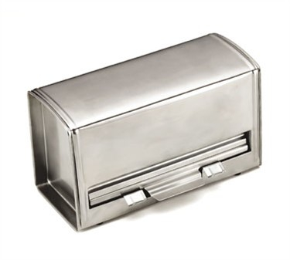
Follow hygiene procedures
Practical action related to single-use items:
Do not ‘build’ or prepare in advance
Use proper containers to dispense drinking straws
Store take-away containers upside down
(Continued)
Notes:
Trainer provides practical measures in relation to single-use items include:
Not preparing take-away containers (for example, pizza boxes) in advance and leaving them ‘open’ – this allows airborne and other contamination to settle inside the boxes on the food contact area: pizza boxes should be constructed ‘to order’
Providing drinking straws in containers to allow one straw at a time to be dispensed without others in the container being touched: an alternative is to only use individually wrapped drinking straws
Storing take-away food containers (for food and beverages) upside down – so the food contact surface of the container is not exposed.

Slide 56
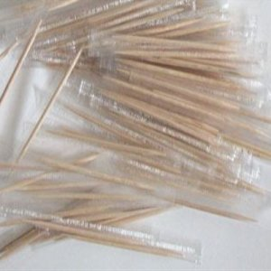
Follow hygiene procedures
Store take-away lids for containers safely
Cover or wrap take-away cutlery
Use wrapped toothpicks
Dispose of damaged PC units
Notes:
Trainer continues providing practical measures in relation to single-use items:
Storing the lids to take away containers safely – so that the side that makes contact with the drink/food is protected
Disposable cutlery should be kept covered or individually wrapped
Toothpicks should be individually wrapped
Disposing of any portion control units which have been damaged or already handled by customers.
Class Activity – Presentation and Demonstration
Trainer:
Presents examples of containers which can be used to safely provide drinking straws to customers
Presents sample PC units/products
Demonstrates correct storage of take-away containers, lids and cutlery.

Slide 57
Summary – Element 2
When following enterprise hygiene standards, procedures and practices:
Implement all necessary personal hygiene practices
Wash hands properly and when required
Use and wear PPE as required
Avoid cross contamination
(Continued)
Notes:
Trainer provides a recap of the Element asking questions to check trainee understanding and responding to questions from trainees, as required.

Slide 58
Summary – Element 2
Consider using colour-coded chopping boards
Prevent unnecessary direct contact with ready-to-eat food
Use disposable gloves
Do not re-use single serve items
Notes:
Trainer provides a recap of the Element asking questions to check trainee understanding and responding to questions from trainees, as required.

Slide 59
Handle and store foodstuffs
Performance Criteria for this Element are:
Handle and store foodstuffs according to enterprise guidelines
Handle and store foodstuffs in a manner that avoids damage and contamination, meets hygiene standards and maintains quality
Store foodstuffs at the correct temperature
Notes:
Trainer identifies for trainees the Performance Criteria for this Element, as listed on the slide.
Class Activity – Discussion
Trainer asks trainees questions about handling and storing foodstuffs by asking questions such as:
What guidelines do you think venues have regarding the safe and effective storage of food?
Why is it important to store food correctly?
What do you think are correct food storage requirements for dry food, refrigerated food and frozen food?
What do you think is meant by the term ‘Temperature Danger Zone’?

Slide 60
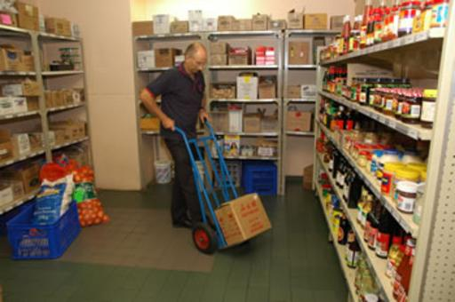
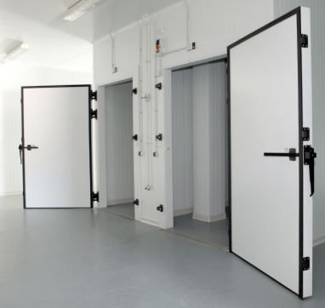
Handle and store food according to enterprise guidelines
There are three storage options for food:
Dry goods storage
Refrigerated goods storage
Frozen goods storage
Notes:
Trainer identifies the three storage options for food explaining details will be provided on following slides:
Dry goods storage
Refrigerated goods storage
Frozen goods storage.

Slide 61
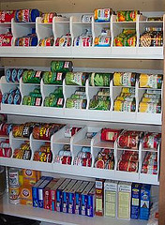
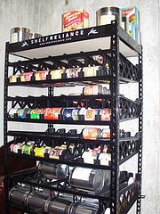
Handle and store food according to enterprise guidelines
Basic food storage requirements:
Use food grade storage equipment
Cover food
Rotate stock
Keep areas clean
Never store food on the floor
Prevent pest infestation
‘Beverages’ are ‘food’.
Notes:
Trainer explains basic/standard safe food handling requirements in relation to food storage are:
Use food grade materials to store food susceptible to contamination – such as stainless steel
Cover food that is in storage to protect it from contamination
Rotate stock to ensure it is used in the correct sequence – the method used for most food is called ‘First In, First Out’: any food exceeding its use-by date must be thrown out (more on later slides)
Keep all storage areas and equipment clean
Never store food (including packaged food) directly on the floor – use shelves or stack on pallets
Ensure pests and rodents are excluded from food storage areas (more on later slides) – conduct a regular (at least weekly inspection to check this, and take appropriate action when evidence of pests or rodents is discovered).
Trainer advises students ‘beverages’ are regarded as ‘food’ and all safe food handling protocols for food apply equally to beverages/drinks.

Slide 62
Handle and store food according to enterprise guidelines
Safe food handling practices when receiving food:
Inspect the food delivered
Inspect the delivery vehicle
Check the practices of the delivery driver
(Continued)
Notes:
Trainer presents safe food handling requirements in relation to food receipt:
Inspect the deliveries – the FSP may require a visual inspection of a set number of deliveries (such as 5%) to make sure:
The food is free from visible contamination – for example:
Frozen food is hard frozen
Packaging and wrapping is not torn
The integrity of tins, bottles and other containers has not been compromised
There are no leaking food containers
The delivery does not bring in pests or rodents
The use-by dates of the food are acceptable – reject any food delivered beyond its use-by date or where it is believed it will not be able to be used before it reaches its use-by date
Inspect the food delivery vehicle – check it is clean and is a dedicated food delivery vehicle
Check the practices of the delivery driver – check things such as:
Whether or not food is protected during the delivery process – is the delivery vehicle left unlocked during deliveries? (It should be locked to prevent unauthorised entry) Is food placed on the footpath? (It should not be) Are there chemicals mixed in with the food items? (No chemicals should be with the food delivered)
Personal hygiene of the delivery driver.

Slide 63
Handle and store food according to enterprise guidelines
Make sure someone is available to receive all deliveries
Check food temperature
Check packaging and labels
Store food promptly after delivery
Notes:
Trainer continues presenting safe food handling requirements in relation to food receipt:
Ensure someone is at the premises to receive the food – deliveries should not be left at the premises unattended as this raises the possibility of contamination (from birds, dogs, cats) as well as potential for theft
Check the temperature of the food in accordance with the requirements of the FSP using a properly calibrated thermometer (see section 3.3):
Frozen food should be hard frozen with no evidence of defrosting: -15ºC is the recommended temperature
Hot food that is ‘potentially hazardous’ must be at 60ºC or above
Potentially hazardous refrigerated food must be at 5ºC or below
Potentially hazardous food may be accepted where the delivery driver can demonstrate (that is, prove to your satisfaction) the combination of time and temperature have not adversely impacted on food safety. In general terms, if the food has been in the Temperature Danger Zone for 2 hours or longer the food should be rejected.
When accepting a delivery of potentially hazardous food that is in the Temperature Danger Zone, it should be used first/immediately and not be subject to the standard stock rotation principle of First In, First Out.
Check all packaged food is properly labelled with the name of the supplier, manufacturer or vendor – all food delivered into a food premises must be able to be identified so as to assist with food recalls and to help identify the source of problems/contamination where an outbreak of food poisoning occurs
Store all deliveries as soon as possible after they have been delivered and checked – never leave refrigerated or frozen food lying around in the receival area.
Class Activity – Demonstration and Practical
Trainer demonstrates how to use a food thermometer (probe type) to take the temperature of refrigerated, frozen and hot food.
Trainer provides opportunity for students to practice doing the same, and checks their technique and accuracy of readings.

Slide 64
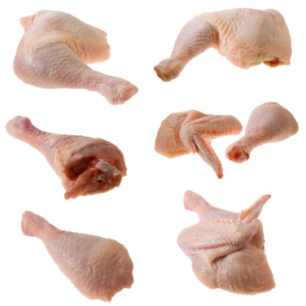
Handle and store food according to enterprise guidelines
‘Potentially hazardous’ food:
Also known as ‘high-risk’ food
Must be stored under temperature-controlled conditions
Range of these foods is potentially endless
High-risk food is mainly
High in protein and moisture
Low acid
Notes:
Trainer introduces concept of ‘potentially hazardous food’ stating:
Potentially hazardous food is food that must be stored under special temperature conditions (out of the Temperature Danger Zone - see later slide) to prevent the growth of food poisoning bacteria or to prevent the formation of toxins in the food.
The list of potentially hazardous food (also known as ‘high risk’ food and/or ‘potentially dangerous’ food) is really without end but focuses on high protein, high moisture, low acid foods.

Slide 65
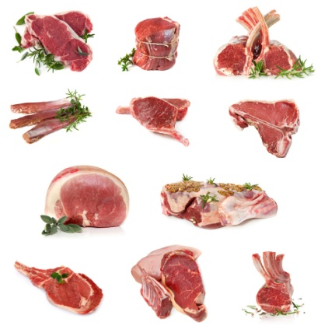

Handle and store food according to enterprise guidelines
Potentially hazardous foods include:
Milk, milk products, cheese
Eggs and egg products
Meat and poultry – all types; all cuts
Smallgoods
Processed meat products
Fish, shellfish and seafood
Pizza, prepared meals, filled sandwiches and rolls, cooked rice and pasta
Notes:
Trainer provides examples of potentially hazardous foods:
Milk and milk products, soft cheeses – butter, yoghurt, custards, cream cakes, cheese, baked custard tarts and dips
Egg products – quiche, fresh pasta, duck and game bird eggs, all eggs, mayonnaise (whole egg)
Meat and poultry – all types of meat (beef, lamb, pork, chicken, turkey) and all cuts (sides, loins, steaks, chops, ribs, mince)
Smallgoods products – ham, pressed chicken, but note most salami is not a high risk food due to its high salt and low moisture content
Processed meat products including chicken – pate, meat pies, sausages, sausage rolls, coagulated blood, rissoles, meat balls
Fish, shellfish, fish products, fish soups and fish stocks – caviar, fish balls, patties, salads, sauces and stews
Other food dishes – pizza, prepared meals, sandwiches, salads and cooked rice and cooked pasta.
Class Activity – Presentation
Trainer shows students a range of food items which are classified as ‘potentially hazardous’ foods.

Slide 66
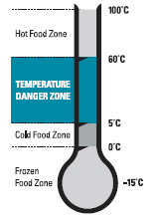
Handle and store food according to enterprise guidelines
Temperature Danger Zone:
The temperature range in which food poisoning bacteria multiply most rapidly
This is 5˚C to 60 ˚C
Keep food out of this range OR minimize time food spends in this range
All time food spends in this temperature range is cumulative
Notes:
Trainer explains Temperature Danger Zone stating:
The Temperature Danger Zone is the temperature range in which food poisoning bacteria multiply most rapidly
The range is 5ºC to 60ºC
Every effort must be made to keep potentially hazardous food out of this temperature range
Where food has to be in this range (such as when it is being prepared), the amount of time it spends in this zone must be minimized
It is important to note all time food spends in the Temperature Danger Zone is cumulative
If a piece of meat is left out on the bench for one hour, refrigerated and then brought back out into the kitchen, the time it then spends in the Temperature Danger Zone is added to the previous time – the clock (and the bacteria count) does not get reset to zero when the food was put in the fridge again.

Slide 67
Handle and store food according to enterprise guidelines
The ‘2/4 rule’:
Potentially hazardous food which has been in the Temperature Danger Zone for 4 hours or more must be thrown out
Potentially hazardous food which has been in the Temperature Danger Zone for 2 hours can be refrigerated and then returned to the Temperature Danger Zone for another 2 hours
High-risk food which has been in the Temperature Danger Zone for 2 hours must be cooked or eaten within next 2 hours or be thrown out
Notes:
Trainer explains awareness of the 2/4 rule is critical in applying safe food handling procedures explaining the 2/4 rule states:
Potentially hazardous foods which have been in the Temperature Danger Zone for four hours (or more) must be discarded/thrown out
Potentially hazardous foods that have been in the Temperature Danger Zone for two hours can be refrigerated and then returned to the Temperature Danger Zone for another two hours, maximum
When high risk food has been in the Temperature Danger Zone for two hours it must be cooked or eaten within the next two hours or thrown out.
There are no exceptions to this rule.

Slide 68
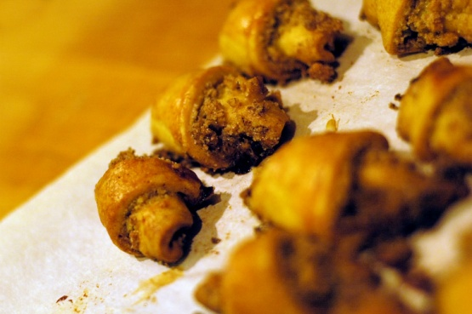
Handle and store food according to enterprise guidelines
‘Two-step’ rule for cooling hot high-risk food:
Step 1:
Cool hot food to 21˚C within 2 hours
Step 2:
Once it has reached 21˚C it must reach 5˚C (or less) within a further 4 hours
High-risk not conforming to these requirements must be thrown out
Notes:
Trainer introduces the two-step rule for the cooling of high risk hot food explaining:
Step 1: Cool hot food down from 60°C (or above) to 21°C within two hours of removing the food from the stove, oven or other cooking unit
Step 2: Once the food has reached 21°C it should be placed into a refrigerator/cool room, and then cooled to 5°C (or below) within a further four hours
If the cooling of high risk food does not meet these criteria, the food must be thrown out
Once food has reached 5°C it can safely be put in the freezer.
Class Activity – Discussion
Trainer asks trainees how they might cool down hot food and monitor the activity to make sure requirements are complied with.
Responses may include:
Cooling in small amounts
Frequent stirring
Placing containers into ice water baths
Using a fan to cool items down
Setting timers to notify of times
Using food thermometer to test temperatures.

Slide 69
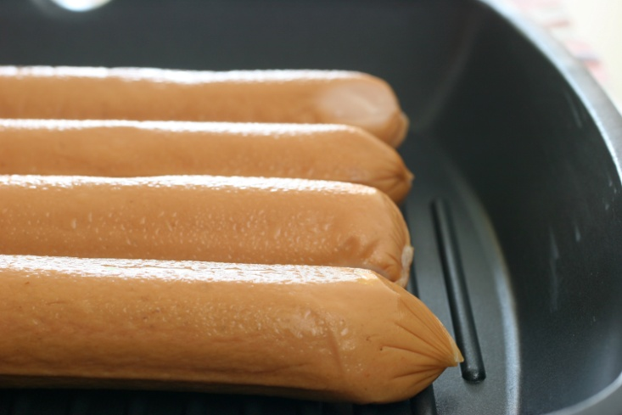
Handle and store food according to enterprise guidelines
Thawing or defrosting frozen food:
Must occur:
Under refrigeration, or
In a microwave, or
Under cold running water
Must not occur by:
Placing into sink of water or bowl of water, or
Leaving items on bench for prolonged period
Notes:
Trainer discusses thawing of frozen food stating:
Frozen food must be thawed before use (also known as ‘defrosting) using one of three methods:
In a refrigerator/coolroom – large pieces of meat may take two to three days to defrost so planning ahead is vital: this is the preferred method of thawing as the food is always out of Temperature Danger Zone
If pressed for time, use a microwave to defrost, moving pieces of food during the procedure – food should be immediately cooked once taken from the microwave after defrosting
Run the item under cold water (less than 20°C) – only suitable for small portions/items. Not suitable for products which have been ‘breaded’ or ‘crumbed’.
All meats should be cooked immediately after thawing.
It is not acceptable to thaw items out by placing them in a bowl or sink of water.
Class Activity – Demonstrations
Trainer demonstrates how to thaw frozen food using the three methods described on the slide.

Slide 70
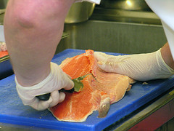
Handle and store food according to enterprise guidelines
‘Clean’ means:
Free from visible contamination
and
Free from odor
Notes:
Trainer defines ‘clean’ as:
Free from visible debris/contamination (dirt, food, grime)
and
Free from objectionable odour (which has relevance to the need for premises to have waste bins which are clean).

Slide 71

Handle and store food according to enterprise guidelines
Safe food handling practices when preparing food:
Ensure all food used is safe and fit for consumption
Protect food during preparation
Wash and sanitize fruit and vegetables
Excluding unhealthy staff from food prep areas and duties
(Continued)
Notes:
Trainer presents safe food handling requirements in relation to processing/preparing food:
Ensuring only safe and suitable food is processed – food unfit for consumption must not be processed. This includes:
Foods that look or smell ‘off’ or shows other signs of contamination
Food that has exceeded its use-by date
Protecting food being prepared from contamination – this includes preventing contamination from:
Physical sources
Chemicals
Microbiological contamination – which may be caused by leaving potentially hazardous food in the Temperature Danger Zone for too long while it is being processed, or failing to cook food at the correct temperature. High risk food should reach an internal temperature of 75ºC which should be verified with a thermometer
Ensuring all fruit and vegetables are washed in a sanitizing solution before being prepared
Excluding unhealthy people from food handling/processing activities – food processing activities including chopping, cooking, drying, fermenting, heating, pasteurising, thawing and washing, or a combination of these activities.
Class Activity – Demonstrations
Trainer demonstrates safe food handling practices as identified on the slide.

Slide 72
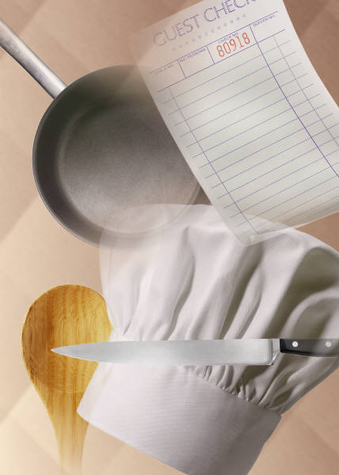
Handle and store food according to enterprise guidelines
Use only clean and sanitized equipment and utensils
Separate chemicals from food
Keep batches separate
Do not touch cooked or ready-to-eat food with bare hands
(Continued)
Notes:
Trainer continues presenting safe food handling requirements in relation to processing/preparing food:
Using clean equipment and utensils that have been sanitized and which are in proper working order – any piece of food equipment not working properly either raises safety and welfare risks for staff or presents the possibility the food processing job it was intended to do (such as to cook food to a certain temperature, or store/display food at a certain temperature) may not be achieved
Ensuring chemicals are kept separated from food and food utensils and equipment during processing
Keeping individual batches of processed food separate – batches of prepared food should never be mixed together as this can give rise to situations where food may remain able to be served even though it has passed its safe food date/time
Avoiding touching cooked/ready-to-eat food with the bare hands where it will not be subsequently cooked.
Class Activity – Demonstrations
Trainer demonstrates safe food handling practices as identified on the slide.

Slide 73
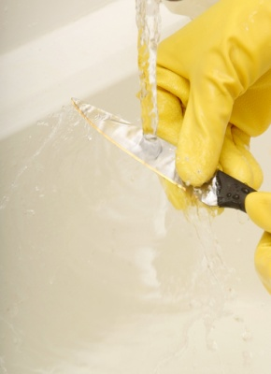
Handle and store food according to enterprise guidelines
Throw out all food dropped on the floor
Wash and sanitize utensils dropped on the floor before using them
Do not cough or sneeze over food or food surfaces
Use a tasting spoon (correctly)
Notes:
Trainer continues presenting safe food handling requirements in relation to processing/preparing food:
Discarding any food dropped on the floor – even if it was only on the floor for 1 second
Washing and sanitizing any food handling tool, implement or utensil dropped on the floor before re-using it
Avoiding coughing or sneezing over food or food preparation utensils, equipment or surfaces
Using a tasting spoon to taste dishes (not the spoon used to stir the food) – and not replacing in the food.
Class Activity – Demonstrations
Trainer demonstrates safe food handling practices as identified on the slide.

Slide 74
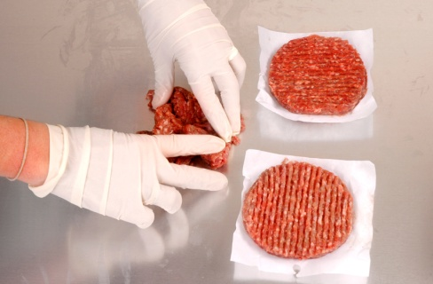
Handle and store food according to enterprise guidelines
Safe food handling practices when using cold display units:
Food must be at 5˚C or below
Keep food covered and protected
Use FIFO principles
Check and record temperature of food at least daily
If refrigerated units are not used there must be another control – such as color-coding or writing times on labels on food.
Frozen food must be displayed so it remains ‘hard frozen’.
Notes:
Trainer presents safe food handling requirements in relation to using cold display units/cabinets:
Food should be at or below 5°C
Food should be covered/wrapped to prevent contamination
Temperatures must be regularly checked (at least daily) and recorded using an independent thermometer
Serve food using FIFO principles
Protective guards must be provided (where appropriate) to prevent customers breathing, sneezing and/or coughing over the food
Pre-prepared sandwiches and filled rolls should be stored in these cabinets – where they are not so stored, some system must apply (such as the use of colour-coded stick-on labels, or written times on the wrapping/container) that will allow control over the length of time the food spends in the Temperature Danger Zone.
Pre-prepared sandwiches and/or filled rolls must not be sold/eaten when they have spent four hours or more in the Temperature Danger Zone.
Class Activity – Demonstrations
Trainer demonstrates safe food handling practices as identified on the slide.

Slide 75
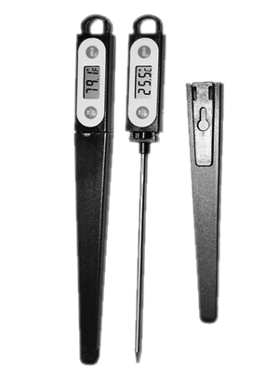
Handle and store food according to enterprise guidelines
Safe food handling practices when using hot display units:
Food must be 60˚C minimum
Pre-heat food before placing into pre-heated unit
Use FIFO stock rotation
Check and record temperatures at least daily
Do not mix batches or top-up up service trays
Notes:
Trainer presents safe food handling requirements in relation to using hot display units/cabinets:
The temperature of the food must be over 60°C (or the 2/4 Rule must be applied)
Food to be put in hot food cabinets must be preheated rapidly before being placed in the cabinet
Food should be served in the order it was placed in the cabinet to minimise risk of contamination (as well as guard against loss of taste, appearance and quality)
Hot foods left from the day before should be served first, following the guidelines set out in ‘Re-heating previously cooked food’ – foods can only be re-heated once. Note some premises follow a standard operating procedure of discarding all left-over food
Temperatures of food must be regularly checked (at least daily) using an independent thermometer
Food must not be topped-up but rotated to keep it fresh and avoid mixing batches.
Class Activity – Demonstrations
Trainer demonstrates safe food handling practices as identified on the slide.

Slide 76
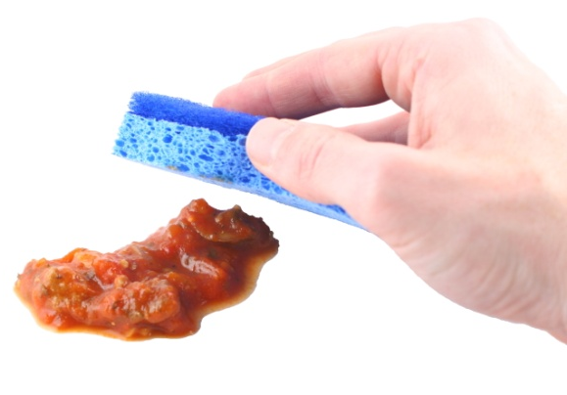
Handle and store food according to enterprise guidelines
Safe food handling practices for self-service situations:
Monitor customers
Pay special attention to children
Ensure hot food stays hot and cold food stays cold
Clean and sanitize or replace any dropped service utensils
Clean spills up immediately
(Continued)
Notes:
Trainer presents safe food handling requirements in relation to situations where customers serve themselves and/or there is unpackaged ready-to-eat food:
Customer activities are routinely and regularly monitored so unsafe practices can be identified and remedial action taken – this means a staff member must be appointed to watch the customers in order to prevent them from doing anything to compromise the food, and/or to remove food from sale/service when it has been contaminated
Special attention is paid to children at self-serve areas – they are prone to handling food with their hands, and taking food from displays and then putting it back
Hot food is kept hot (60°C and above), and cold food is kept cold (5°C and below) or the 2/4 rule is applied
Any utensils dropped by customers are immediately replaced with clean and sanitized ones
Spills are cleaned up immediately.
Class Activity – Demonstrations
Trainer demonstrates safe food handling practices as identified on the slide.

Slide 77

Handle and store food according to enterprise guidelines
Discard contaminated food
Use advisory signs
Cover and protect foods
Provide separate utensils for each food type
Use sneeze-guards
(Continued)
Notes:
Trainer continues presenting safe food handling requirements in relation to situations where customers serve themselves and/or there is unpackaged ready-to-eat food:
Any contaminated food is thrown out – this includes contamination by customers coughing or sneezing over the food
Signs are posted advising customers of safe food handling practices – such as asking them not to use utensils in other foods, to refrain from coughing and sneezing over the food, to refrain from handling any of the food with their bare hands
Foods are covered and protected from contamination when not actually being used
Separate utensils are provided for each and every food item
Sneeze-guards are in place and are constructed/positioned to be effective.
Class Activity – Demonstrations
Trainer demonstrates safe food handling practices as identified on the slide.

Slide 78

Handle and store food according to enterprise guidelines
Do not mix food batches
Throw out ‘plate waste’
Display small amounts of food
Provide extra service utensils
Provide ‘rests’ for service gear
Apply 2/4 rule
Notes:
Trainer continues presenting safe food handling requirements in relation to situations where customers serve themselves and/or there is unpackaged ready-to-eat food:
Batches and/or trays of food items are not mixed – stock rotation is important but so is keeping batches separate
Throw out any plate waste/returned food
Small batches of food are put out – and replaced frequently, rather than putting out a large tray/platter to begin with
Extra utensils are provided – there always seems to be a need for more
Clean ‘rests’ for utensils (spoons and other service utensils) are provided and changed regularly to prevent cross-contamination
The 2/4 rule is being complied with.
Class Activity – Demonstrations
Trainer demonstrates safe food handling practices as identified on the slide.

Slide 79
Handle and store food according to enterprise guidelines
Safe food handling practices when transporting food:
Use a food transport vehicle
Maintain vehicle and food containers in clean condition
Keep raw and cooked foods separate
Keep hot food at 60˚C+ or deliver within 2 hours
Keep cold food at 5˚C (or below) or deliver within 2 hours
(Continued)
Notes:
Trainer presents safe food handling requirements in relation to food transportation:
A dedicated food delivery vehicle is used – food should not be transported in family cars
The food storage area of the delivery vehicle is maintained in a clean condition been cleaned – also, any boxes, containers, transport boxes (including warmers/heaters) used to store food during transport must be clean
Raw and cooked/ready-to-eat foods are kept physically separate – to avoid cross contamination
The temperature of hot and cold food is checked prior to being loaded – hot food to be 60°C or above, and cold food to be 5°C or below: frozen food to be hard frozen
Where hot food cannot be held at 60°C or above, it will need to be able to be delivered within two hours
Where cold potentially hazardous food cannot be held at 5°C or below, it will 100% definitely need to be able to be delivered within two hours.
Class Activity – Demonstrations
Trainer demonstrates safe food handling practices as identified on the slide.

Slide 80
Handle and store food according to enterprise guidelines
Pre-cool vehicle before loading refrigerated food
Load refrigerated food at 5˚C or below
Monitor and record times and temperatures of food and vehicle
Load food immediately prior to delivery
Cover and protect food
(Continued)
Notes:
Trainer continues presenting safe food handling requirements in relation to food transportation:
Refrigerated food delivery vehicles must be able to hold food outside the Temperature Danger Zone – this may require the vehicle to be connected to mains power and pre-cooled prior to food being loaded into the vehicle
Temperatures (and times) of food items are recorded onto a Food Delivery-Transportation log (or similar) when they are loaded into the food delivery vehicle
Food is not loaded into the delivery vehicle until it is ready to be delivered
All food is covered to protect it from contamination.
Class Activity – Demonstrations
Trainer demonstrates safe food handling practices as identified on the slide.

Slide 81
Handle and store food according to enterprise guidelines
Maintain and service the vehicle regularly
Do not load food along with chemicals
Pets or animals are not permitted in the vehicle
Lock vehicle doors when it is unattended
Notes:
Trainer continues presenting safe food handling requirements in relation to food transportation:
The delivery vehicle itself has been well maintained to minimise the risk of vehicle breakdown during food delivery
Chemicals are not stored/transported with food items – chemicals can be carried in the same vehicle as food but they must in a separate part of the vehicle
No pets/animals are allowed in the food delivery vehicle
All doors on the food delivery vehicle should be locked when unattended.
Class Activity – Demonstrations
Trainer demonstrates safe food handling practices as identified on the slide.

Slide 82

Handle and store food according to enterprise guidelines
When working in a bar:
Use fork or tongs to add fruit and ice to drinks
Never re-use ‘plate waste’
Store drinking straws correctly
Verify glass washer has detergent
Use de-naturing agent in beer trays
(Continued)
Notes:
Trainer presents specific requirements for people who work in a bar:
Use a fork or tongs when putting fruit or ice in a glass – do not use fingers
Do not re-use any fruit, straws, beverage, food, garnish left by a guest, or which comes back from the tables – it must be thrown out
Ensure straws are correctly stored – they must be stored so they are kept free from flies, dust and contamination. They must be able to be obtained one at a time without the others being touched so it is not acceptable to store straws in a glass on the bar
Check glass washing machine has detergent, and is operating at the prescribed temperature (which is 70° C)
Put de-naturing agent in drip trays (drip trays are trays which are placed under beer drawing taps to catch the drips/overflow from glasses) – there must be sufficient de-naturing agent to actually de-nature the waste beer and stop premises pouring this waste beer back into the barrel.
Class Activity – Demonstrations
Trainer demonstrates safe food handling practices as identified on the slide.

Slide 83
Handle and store food according to enterprise guidelines
No smoking or spitting
Wash hands
Wear clean clothes
Stay away from work when ill
Ensure all glassware is clean
Ensure all utensils are clean
Notes:
Trainer continues presenting specific requirements for people who work in a bar:
No smoking or spitting behind the bar
Wash hands at all times that kitchen-based food handlers are required to wash their hands
Ensure clean clothes, hands and fingernails
Stay away from work if ill or suffering from an infected cut: notify doctor of food handler status – bring a medical clearance stating fitness for work on return
Ensure all glassware and utensils are clean – plates and glasses must also be free of chips and cracks.
Class Activity – Demonstrations
Trainer demonstrates safe food handling practices as identified on the slide.

Slide 84
Handle and store food to protect it and maintain quality
Requirements for dry goods store:
Fly and vermin-proof
Well lit and ventilated
Not crowded or over-stocked
Tight-fitting doors
Bottom shelf allows broom and mop access
(Continued)
Notes:
Trainer describes dry goods store and identifies requirements:
The area is fly- and vermin-proof to minimise contamination by pests
It is well ventilated and lit – to deter pests and to allow staff to see what they are doing and identify and remedy spillages
It is never overstocked – excess stock costs money, clutters things up, and increases the chance of out-of-date stock being used
It is fitted with doors which make a proper fit when fully closed to help exclude pests
The lowest shelf is sufficiently far enough above floor level to enable air circulation around produce, and to allow mops and brooms to reach under the shelves when cleaning is required.
Class Activity – Demonstrations
Trainer demonstrates requirements for storage as identified on the slide.

Slide 85

Handle and store food to protect it and maintain quality
Use proper food containers:
Made from food-grade materials
With tight-fitting lids
Clean and sanitize containers
Transfer food from open cans to suitable containers and refrigerate
Notes:
Trainer continues describing dry goods store and identifies requirements:
Bulk food containers used are made from food grade materials and have tight-fitting lids – plastic garbage bins (even brand new/unused ones) are not permitted to be used for food storage as they are liable to splitting, do not have a smooth internal surface that facilitates cleaning and do not protect against mice and rats
Food storage containers are cleaned and sanitized before being re-used/re-filled – to guard against batch-mixing
Any canned, tinned or bottled food must be transferred to an appropriate container and refrigerated once the container has been opened – it is not acceptable (for example) to open a can, use half of the contents and then return the open can to dry storage. The food must be transferred to a plastic or stainless steel (or other appropriate) container and then placed in the refrigerator.
Class Activity – Demonstrations
Trainer demonstrates requirements for storage as identified on the slide.

Slide 86

Handle and store food to protect it and maintain quality
Requirements for refrigerated storage:
Keep temperature at or below 5˚C
Check and record temperature at least daily
Close doors between use
Do not crowd or overstock
(Continued)
Notes:
Trainer describes refrigerated storage and identifies requirements:
The temperature is kept at 5°C or below and this temperature is checked with an independent calibrated thermometer – checks must be done at least once per day
The coolroom/refrigerator door is closed between uses and an effort made to minimise opening times by planning these openings – an open door raises the temperature and makes the unit more expensive to operate
The cool room is not overcrowded to enable air to circulate freely around food items.
Class Activity – Demonstrations
Trainer demonstrates requirements for storage as identified on the slide.

Slide 87
Handle and store food to protect it and maintain quality
Store hot food in small amounts to facilitate cooling
Cover and protect food
Label food – where required
Separate raw high-risk food from cooked or ready-to-eat food
Notes:
Trainer continues describing refrigerated storage and identifies requirements:
Food loads put into the coolroom/refrigerator are broken down into smaller units to enable faster cooling: where large units of food are placed in the refrigerator it takes a lot longer for the core of that food to move out of the Temperature Danger Zone.
Hot foods should be allowed to cool (perhaps by placing the food in pots into tubs full of a water-ice mixture) before being placed in the cool room: frequent stirring of the item will help it to cool quicker.
If ‘too much’ hot food is placed into refrigeration it will raise the temperature of the unit and may cause condensation which could lead to cross-contamination (see below).
The ‘Two-step rule for cooling hot foods’ (see below) must be complied with.
All food is covered and protected from contamination – plastic film with a label attached to identify the food and date it was placed under refrigeration may be used
Potentially hazardous raw food is separated from cooked and/or ready-to-eat foods – this is to prevent cross contamination.
Class Activity – Demonstrations
Trainer demonstrates requirements for storage as identified on the slide.

Slide 88

Handle and store food to protect it and maintain quality
Frozen food storage requirements:
Operate at -15˚C or below
Do not freeze hot food
Never re-freeze thawed items
Defrost freezers regularly
(Continued)
Notes:
Trainer describes frozen food storage requirements:
Must keep food at -15˚C or below – many venues will operate freezers at -18˚C: food must stay hard frozen
Hot food is never frozen – cool it first following the two-step rule for cooling hot food
Thawed items must never be refrozen
That freezers are defrosted regularly to maintain operating effectiveness and encourage use (or disposal) of items.
Class Activity – Demonstrations
Trainer demonstrates requirements for storage as identified on the slide.

Slide 89
Handle and store food to protect it and maintain quality
Close freezer doors between uses
Check and record temperature at least daily
Freeze ‘small’ not ‘large’ amounts
Follow manufacturers’ instructions regarding freezing of food products
Notes:
Trainer continues describing frozen food storage requirements:
Freezer doors are kept closed when the freezer is not in use
Freezer temperature is be checked at least daily to ensure correct operating temperature
Large pieces/amounts of food are not frozen as this encourages others to defrost the item and then re-freeze it – in practice this means:
Freezing slices rather than slabs of meat
Using shallow storage containers rather than deep ones
Manufacturer’s instructions regarding the storage of frozen food products are followed – these may relate to storage temperatures and the length of time the product can be stored (for quality ands/or safety reasons).
Class Activity – Demonstrations
Trainer demonstrates requirements for storage as identified on the slide.

Slide 90
Handle and store food to protect it and maintain quality
FIFO stock rotation:
First In, First Out
Common practice for rotating food and beverage stock
Move old stock forward on shelf and place new stock behind existing stock
Put new stock below or beneath existing stock
Notes:
Trainer explains FIFO stock rotation explaining effective stock rotation for foods means using the FIFO approach to stock rotation – First In, First Out:
This method requires food is used/served in the order it was delivered meaning the foods which have been in stock the longest are used first.
In practice this means when storing food:
Old/existing stock must be moved forward on the shelf and the newly delivered stock must be placed behind it – this allows the stock at the front (the oldest stock) to be used before the newer stock
Existing product in a chest freezer should be removed and the new stock placed at the bottom of the freezer – the existing/old stock is then replaced in the freezer on top of the newer stock.
Class Activity – Demonstrations
Trainer demonstrates practical application of FIFO stock rotation in relation to:
Food on shelves
Food in refrigerators
Food in freezers.

Slide 91
Handle and store food to protect it and maintain quality
Cleaning requirements:
Premises need to be kept clean
Fixtures and fittings must be kept clean
Cleaning equipment must be cleaned after use
Notes:
Trainer presents ‘cleaning’ requirements explaining businesses are required to keep their food premises and equipment clean which can be seen as:
A state in which there is no accumulation of:
Garbage, except in garbage containers
Recycled matter, except in containers
Food waste
Dirt
Grease
Other visible matter.
The business must also maintain all its fixtures, fittings and equipment (in a clean condition.
This requirement applies to things such as walls, floors, ceilings, windows, benches, shelves, sinks, wash hand basins, cupboards, grease filters, cooking equipment, food preparation equipment, food utensils, food vending machines, light fittings, ventilation ducts, pipes and electrical wiring.
Equipment used to do the cleaning (for example, brooms, mops and buckets, hoses) must also be cleaned – they should be cleaned, washed and/or sanitized after each use.

Slide 92

Handle and store food to protect it and maintain quality
Cleaning tools and equipment:
Clothes | Brushes | Sponges
Towels | Spray bottles | Grill cloths
Abrasive pads | Scrapers | Paper towel
Notes:
Trainer identifies cleaning tools and equipment used in a kitchen to clean food equipment as listed on slide.
Class Activity – Presentation
Trainer (or representative from cleaning supply company):
Presents sample items for each product listed
Identifies use of each.

Slide 93

Handle and store food to protect it and maintain quality
Cleaning agents and chemicals:
Detergents | Sanitizers | Degreasers
Oven cleaners | Grill cleaners | Rinse aids
Combi-oven cleaners | Glass cleaners | Descalers
Dishwashing detergents | Multi-purpose cleaners | Cooktop cleaners
Notes:
Trainer identifies range of cleaning agents/chemicals used to clean equipment in a kitchen as listed on slide:
Class Activity – Presentation
Trainer (or representative from cleaning supply company):
Presents sample chemicals as listed on slide
Identifies use/s for each
Demonstrates how to use each chemical
Identifies safety issues.

Slide 94
Handle and store food to protect it and maintain quality
General cleaning procedure for food equipment:
Allowing items to cool before cleaning them
Checking with other staff
Gathering required tools and chemicals
Knowing the specific procedure for individual items
Cleaning ‘in place’ or moving to sink
Pre-cleaning then washing
Rinsing
Sanitizing
Notes:
Trainer presents general cleaning procedures and techniques for food preparation equipment which can include:
Allowing item to cool down before cleaning or disassembly (where required)
Checking with other staff to determine item:
Is no longer required and can be cleaned
Needs to be cleaned
Ensuring required cleaning tools, equipment and cleaning agents/chemicals are available
Cleaning the item where it is physically located – or moving it to the cleaning area
Making sure you know and/or have access to the required cleaning procedures and techniques for the individual item
Pre-cleaning items – such as:
Physically removing food scraps/debris
Using bristle brush to remove food debris
Rinsing
Soaking in detergent solution
Washing items:
Thoroughly
Using hot water
Using designated/appropriate detergent for the item and the cleaning job to be performed
Scrubbing
Using abrasive pads as/if required
Rinsing items
Sanitizing the item – using hot water, steam or chemicals.

Slide 95

Handle and store food to protect it and maintain quality
Cleaning instructions – may be available and will detail:
Item or area to be cleaned
When cleaning is required
Cleaning equipment and chemicals required
Cleaning procedure
Notes:
Trainer explains some venues have detailed cleaning instructions to guide staff in the cleaning of food equipment, utensils and areas.

Slide 96
Handle and store food to protect it and maintain quality
Sample cleaning instruction:
Job | Description
Utensils and cutting boards – Daily | Clean utensils and cutting boards as required during trade and at the end of each day’s trade Remove dry soil and debris and rinse with warm water Wash with XYZ detergent, soaking as required; rinse and sanitize Rinse and allow to air dry
Notes:
Trainer provides example of cleaning instruction for ‘utensils and cutting boards’ as shown on slide.
Class Activity – Demonstration and Practical
Trainer demonstrates how to follow cleaning instructions for cleaning:
A cutting/chopping board
Several food utensils
Trainer provides opportunity for students to practice same.

Slide 97
Handle and store food to protect it and maintain quality
Sample cleaning instruction:
Job | Description
Microwave – Daily | Clean the microwave as required during trade and at the end of each day’s trade Wipe away loose debris and dirt with a clean cloth Spot-clean or scrape identifiable problem areas Wash with detergent and hot water, rinse and sanitize Rinse and allow to air dry
Notes:
Trainer shows another example of cleaning instruction as per slide.
Class Activity – Demonstration and Practical
Trainer demonstrates how to follow cleaning instructions for cleaning:
Microwave
Trainer provides opportunity for students to practice same.

Slide 98
Handle and store food to protect it and maintain quality
Sample cleaning instruction:
Job | Description
Bain Marie – Daily | Clean the Bain Marie at the end of each day’s trade Remove Bain Marie trays and wash them in sink using detergent and hot water, rinse and sanitize Rinse and allow to air dry Wash main unit (including any hot press and plate warmer cabinet) using detergent and hot water, rinse and sanitize: rinse and allow to air dry
Notes:
Trainer shows another example of cleaning instruction as per slide.
Class Activity – Demonstration and Practical
Trainer demonstrates how to follow cleaning instructions for cleaning:
Bain marie.
Trainer provides opportunity for students to practice same.

Slide 99

Handle and store food to protect it and maintain quality
In relation to cleaning in kitchen and food areas:
Cleaning instructions MUST be adhered to
A ‘cleaning schedule’ will identify individual staff with responsibility for cleaning items at nominated times and days
Notes:
Trainer provides additional information about cleaning:
Cleaning instructions/directions must be followed – they are not optional
Venues who have developed cleaning instructions will also generate cleaning instructions to identify names of individual staff with responsibility for cleaning designated items/areas at set times and/or on stated days of the week.
Class Activity – Individual Exercise
Trainer asks trainees to develop sample cleaning instructions for one item of food preparation/cooking equipment.

Slide 100

Store food at correct temperature
Dry goods store:
Non-refrigerated
For canned, bottled and dried food
May be room-size or cupboards or shelves
15˚C to 20 ˚C
Notes:
Trainer presents temperature information for storing dry goods:
The dry goods store is a non-refrigerated store where canned and dried food are kept
It may be room-size, or a variety of cupboards and/or pantries
Desired temperature for dry store should be in the range 15°C to 20°C.

Slide 101
Store food at correct temperature
Refrigerated stores -
Cool rooms and other units
General requirements is 5˚C or below
Many operate at lower temperature
Meat and seafood – best at 1˚C to 2˚C
Notes:
Trainer presents temperature information for storing refrigerated goods:
Refrigerated storage is used for perishable fresh products such as fruit and vegetables, dairy products, eggs, meat, poultry and seafood.
The basic requirement is storage is at 5°C or below: many operate at 2°C
Meat poultry and seafood are best stored fresh at 1°C to 2°C
If purchasing on daily basis this means a high turnover and 4°C is sufficient but if high risk foods are purchased less frequently then colder temperatures are best
Fruit and vegetables require less severe temperature:
Tomatoes can be stored in the dry store if they are purchased regular basis.
Most vegetables only require refrigeration to keep their quality, not for food safety reasons.
Refrigerated storage may occur in cool rooms, under-counter refrigeration units or domestic refrigerators.

Slide 102

Store food at correct temperature
Freezers:
Store frozen food
May be walk-in, upright or chest type
Must keep food ‘hard frozen’
-15˚C to -18 ˚C.
Notes:
Trainer presents temperature information for storing refrigerated goods:
Freezers are used to store frozen produce
Freezers may be chest type, up-right, or walk-in, but they must be maintained such that the food remains hard frozen – domestic freezers can be used in commercial situations
Standard operating range is -15°C to -18°C.

Slide 103


Store food at correct temperature
Temperatures for displaying potentially hazardous food:
Cold food: at or below 5˚C
Hot food: at or above 60˚C
Frozen food: kept ‘hard frozen’
Notes:
Trainer recaps display temperatures for potentially hazardous food :
Cold food – at 5°C or below. Between 1°C and 5°C will keep high risk food out of the Temperature Danger Zone and prevent freezing of product (which makes it unattractive and unappealing to customers)
Hot food – at 60°C or above
Frozen food – maintained in a ‘hard frozen’ state (in the range of -15°C to -18°C or below).
Class Activity – Discussion
Trainer asks trainees:
Define ‘potentially hazardous food’
Give examples of potentially hazardous food.

Slide 104

Store food at correct temperature
Probe thermometer (not infra-red):
Should be available for use when required
Calibrate at least every 6 months
Must be accurate to +/-1˚C
Clean and sanitize between uses
Allow to reach room temperature in between use on hot and cold foods
Treat with care
Notes:
Trainer states food premises should have a probe thermometer explaining this thermometer must be:
Readily available for food handling staff to use as required
Checked/calibrated very six months (minimum) to ensure it is giving an accurate reading. Instructions on how to do a hot and cold calibration to check the accuracy of the thermometer are sometimes included in the instructions that accompany the thermometer when it is purchased.
Thermometers must be accurate to +/- 1ºC or they must be repaired or replaced.
Cleaned and sanitized between uses when it is being used to check the temperature of food – the use of a sanitizing wipe to achieve this is common
Allowed to reach room temperature when being alternated between use on hot and cold food or vice versa
Treated with care – do not knock, drop or damage it: if it is knocked, dropped or damaged, it should be immediately checked for accuracy.
Class Activity – Demonstrations
Trainer shows students:
How to use probe thermometers in hot and cold food to measure temperature
How to use probe thermometer to take temperature of frozen items
How to read temperature of cool room using probe thermometer
Use of infra-red thermometer highlighting limitations of this type as it can only provide a surface reading.

Slide 105

Store food at correct temperature
Cold calibration:
Make/mix ice slurry (50% water 50% ice) and allow to stand for 5 minutes
Insert probe into mixture
Record reading – should be 0˚C
Repair or replace if reading is outside +/-1˚C
Notes:
Trainer explains manufacturer’s instructions when calibrating thermometers:
Cold Calibration
The following procedure must be applied at least every six months (some do every month) for the ice point calibration of thermometers:
Put ice and pre-cooled water (about half-and-half) into a container and allow to stand for about five minutes
Insert the probe of the thermometer into the ice-water mixture and allow to stand for two minutes
Record temperature reading – it should be 0°C – on Equipment Calibration Log, Independent Thermometer Calibration Record (or similar)
Replace, repair or get recalibrated if temperature reading is ±1°C or more.
Class Activity – Demonstration and Practical
Trainer demonstrates how to do ice point calibration and provides opportunity for students to practice same.

Slide 106

Store food at correct temperature
Hot calibration:
Boil water
Insert probe into water
Record reading – should be 100˚C
Repair or replace if reading is outside +/-1˚C
Notes:
Trainer explains manufacturer’s instructions when calibrating thermometers:
Hot Calibration
The following procedure must be applied at least every six months (some do every month) for hot calibration of thermometers:
Boil water and place thermometer probe into the boiling water
Allow to stand for two minutes
Record temperature reading – should be 100°C – on Equipment Calibration Log, Independent Thermometer Calibration Record (or similar)
Replace, repair or get recalibrated if temperature reading is ±1°C or more.
Class Activity – Demonstration and Practical
Trainer demonstrates how to do hot calibration and provides opportunity for students to practice same.

Slide 107
Summary – Element 3
When handling and storing foodstuffs:
Inspect all food deliveries and reject unsafe or unsatisfactory food
Store food promptly under the correct conditions
Apply FIFO stock rotation
Keep stores neat and clean
(Continued)
Notes:
Trainer provides a recap of the Element asking questions to check trainee understanding and responding to questions from trainees, as required.

Slide 108
Summary – Element 3
Take special care with potentially hazardous foods
Keep time food spends in the Temperature Danger Zone to a minimum
Apply the 2/4 rule at all times
Follow the two-step rule for cooling hot food
(Continued)
Notes:
Trainer provides a recap of the Element asking questions to check trainee understanding and responding to questions from trainees, as required.

Slide 109
Summary – Element 3
Do not thaw food by leaving it on a bench or in a sink or bowl of water
Protect food and food surfaces against contamination
Follow standard protocols for re-heating previously cooked food
Closely monitor all self-serve food situations
(Continued)
Notes:
Trainer provides a recap of the Element asking questions to check trainee understanding and responding to questions from trainees, as required.

Slide 110
Summary – Element 3
Remember beverages are classified as food
Check and maintain storage areas in good condition at required temperatures
Apply organizational requirements for cleaning food items and food areas
Use PPE when handling chemicals
Calibrate food thermometers at least every six months
Notes:
Trainer provides a recap of the Element asking questions to check trainee understanding and responding to questions from trainees, as required.

Slide 111
Follow food safety program
Performance Criteria for this Element are:
Ensure work activities conform with enterprise food safety program
Identify and monitor areas of risk in individual work area
Take corrective actions within individual scope of responsibilities to minimize risk in accordance with the enterprise food safety program
Report risks beyond the control of the individual to the appropriate person/s
Complete records according to enterprise requirements and work responsibility
Notes:
Trainer identifies for trainees the Performance Criteria for this Element, as listed on the slide.
Class Activity – Discussion
Trainer asks trainees questions about following a food safety program by asking questions such as:
What do you think a food safety program is?
Why do venues have them?
How do you learn about the requirements of the food safety program at your workplace?

Slide 112

Ensure work conforms with food safety program
Venues may have an FSP:
‘Food Safety Plan’ or ‘Food Safety Program – two names for the same thing
FSP may be a legal requirement or may be put in place voluntarily
The FSP provides direction for safe food handling practices at the venue based on an analysis of their operations (products and processes)
Notes:
Trainer states venues may have a Food Safety Plan (also known as a Food Safety Program) explaining the FSP may be:
A legal requirements – there are places where an FSP is a mandatory/legislated obligation
As a result of the venue taking a decision in its own right to put in place a range of safe food handling practices.
Trainer advises a FSP will:
Provide guidelines for safe food handling protocols in the business and compliance with the requirements of the plan is mandatory even where the plan itself is not a legislated requirement
Have been developed after an analysis of the food handling operations of the business.

Slide 113

Ensure work conforms with food safety program
FSP may contain:
Support information and direction in relation to:
Cleaning and sanitizing items and areas
Personal hygiene including health
Equipment and property maintenance
Pest control
Waste disposal
(Continued)
Notes:
Trainer states the FSP will/may:
Contain a range of detailed ‘support’ information on requirements (the safe food handling practices for the venue) for topics such as:
Cleaning and sanitizing – of equipment, utensils and work areas
Personal hygiene practices and requirements
Health of food handlers
Equipment and property maintenance
Thermometer use and calibration
Pest control – see later slides
Waste disposal – see later slides
Identify the food safety records to be established and maintained by the venue
Describe the training all food handlers must receive before they handle food.

Slide 114

Ensure work conforms with food safety program
Safety records which need to be established and maintained:
By name and title
When they need to be completed and by whom
The training food handlers must receive:
Local and mandatory
Extra in-house training
Refresher training
Notes:
Trainer continues explaining (possible) contents of FSP:
Identify the food safety records to be established and maintained by the venue – details on later slides
Describe the training all food handlers must receive before they handle food – training may be local/mandatory training as imposed or required by local health authorities and may also prescribe extra training as well as refresher training.
Class Activity – Presentation
Trainer obtains a copy of a local FSP and:
Distributes and discusses with class.

Slide 115

Ensure work conforms with food safety program
An effective pest control program comprises three elements:
Physical exclusion
Chemical and mechanical control of pests
Sound housekeeping practices
Notes:
Trainer introduces topic of pest control stating effective pest control comprises three elements, all of which have to be implemented and all of which will be detailed on following slides:
Physical exclusion of pests – also known as ‘Build them out’
Chemical and mechanical control – also known as ‘Chase them out’
Sound housekeeping practices – also known as ‘Starve them out’.

Slide 116

Ensure work conforms with food safety program
Physical exclusion involves:
Checking deliveries into the venue and kitchen
Fly wire on doors and windows
Sealing of holes in food area
Exclusion of animals from food areas
Notes:
Trainer explains physical exclusion of pests/vermin involves:
Checking all deliveries – to eliminate pests coming in with foodstuffs
Correct fitting of fly wire to doors and windows – to stop pests entering through doors and windows
Sealing of holes around pipes and other fittings – that allow pests entry to the premises
Exclusion of animals from food areas – as a standard operating practice.

Slide 117

Ensure work conforms with food safety program
Chemical and mechanical control can include:
Electronic fly zappers
Air curtains
Traps
Bait stations
Sprays
Fogging
Professional pest control companies
Notes:
Trainer presents examples of chemical and mechanical control of pests:
Electronic fly zappers – ‘insectocutors’ which use UV light to attract insects and then electrocute them
Air curtains
Traps
Bait stations
Sprays
Fogging
Professional pest control companies – who should:
Inspect the venue first to identify the types of pests present
Be properly licensed/certified.
Class Activity – Presentation
Trainer obtains samples of items listed on slide, presents them to students and discusses their use.

Slide 118
Ensure work conforms with food safety program
Sound housekeeping practices:
Clean and dry environment at end-of-day or shift
Inspect at end-of-shift to ensure no scraps under equipment
No water sources for pests to drink
Remove potential shelter
Store food in vermin-proof containers
Repairs cracked tiles and surfaces
Notes:
Trainer explains need for good/sound housekeeping practices as part of effective pest control providing examples such as:
Ensuring equipment, floors, benches and other areas are properly cleaned at end of shift/day so that no liquid or food remains to serve as a food source for pests and rodents.
Inspecting/checking under items of equipment at end-of-shift to make sure no food scraps are there
Making sure no water remains after cleaning to serve as a drinking source for pests
Removing cartons and other items which may provide shelter for them
Correct storage of food in vermin-proof containers
Making immediate repairs to cracked surfaces and tiles which can provide an inadvertent source of food.
Class Activity – Guest Speaker
Trainer arranges for representative from pest control company to come and talk to students about:
Effective pest control protocols
How to identify signs of infestation
Assistance pest controllers can provide
Cost/charges for services.

Slide 119


Ensure work conforms with food safety program
In relation to waste disposal:
Always wear disposable gloves when handling waste/garbage/rubbish
Always wash hands after handling waste/garbage/rubbish or bins
Notes:
Trainer discusses waste disposal with students presenting two basic requirements:
Wear disposable gloves when handling garbage – and discard after use
Wash hands after handling garbage or bins – even where disposable gloves have been worn.

Slide 120

Ensure work conforms with food safety program
Requirements relating to handling waste within the kitchen:
Empty bins regularly
Empty bins when three-quarters full
Always empty bins at end-of-day or shift
Fit bins with bin liners
Clean in and around bins
Clean bins at end-of-shift
Notes:
Trainer identifies requirements for the handling of garbage within the kitchen can include:
Emptying internal bins regularly
Emptying bins when three-quarters full – and not waiting until they are full/overflowing
Always emptying internal bins at the end-of-shifts/session – never leave waste in bins between shifts or overnight
Using bin liners – of appropriate strength and size for each bin: fix securely
Cleaning in and around bins – lift/move bins and clean under them too
Cleaning bins at the end of each shift/session – using detergent and hot water.
Class Activity – Demonstration and Practical
Trainer demonstrates how to clean internal bins and fit bin liners, and provides opportunity for students to practice same.

Slide 121

Ensure work conforms with food safety program
External waste bins and dumpers:
Must be ‘sufficient’ in numbers
Must have tight-fitting lids
Must be kept in good condition
Must be kept clean
Must be emptied regularly
Apply appropriate recycling
Notes:
Trainer gives requirements for the handling of garbage outside the kitchen in external bins and dumpers:
Ensuring sufficient numbers of bins – to cater for the waste produced by the business
Making sure all bins have tight-fitting lids’
Keeping lids closed when bins are not in use – to help prevent access to garbage by pests
Ensuring bins/dumpers are in good condition – to prevent leaks and protect against access by vermin
Cleaning the external bins and dumpers – using detergents, degreasers and deodorants
Emptying external bins on a regular basis – to help avoid accumulation of rubbish and objectionable odours
Applying appropriate recycling techniques.

Slide 122


Identify and monitor areas of risk in individual work area
Basics for identifying and monitoring your work area in relation to food safety:
‘Poor organisational practices’ are often the cause of problems
All food handlers have responsibility for identifying, monitoring and reporting issues
‘Poor organisational practices’ include sub-standard staff performance
Notes:
Trainer introduces basics for identifying & monitoring risk:
An area of risk is frequently the result of poor organizational practices
All food handlers are under an obligation to identify and report poor organizational practices that are inconsistent with required hygiene procedures
This requirement applies whether the unsafe/poor practice relates to an organizational policy or procedure, or if it relates to the activities/practices of an individual food handler
Poor organizational practice includes sub-standard performance by staff and compromise the requirements of your workplace FSP.

Slide 123

Identify and monitor areas of risk in individual work area
Poor organizational practices :
Poor personal hygiene practices
Poor food handling practices
Poor cleaning practices
(Continued)
Notes:
Trainer states it is impossible to identify an all-inclusive list of possible bad/sub-standard practices but they are likely to fall into one of the following categories:
Poor personal hygiene practices
Poor food handling practices that may result in the contamination of food
Poor cleaning practices that may result in cross contamination of food and other items including food preparation equipment, utensils and surfaces.
Class Activity – Discussion
Trainer leads a question on the poor organizational practices listed on the slide by asking questions such as:
What are examples of poor personal hygiene practices?
Why are they a problem?
What are examples of poor food handling practices?
Why are they a problem?
What are examples of poor cleaning practices?
Why are they a problem?

Slide 124

Identify and monitor areas of risk in individual work area
Practices which do not align or comply with FSP requirements
Out-of-date practices
Use of damaged equipment
Staff without proper training
Notes:
Trainer continues providing examples of poor organizational practices:
Practices that are inconsistent with the FSP for the premises
Implementation and continuation of food handling practices that are out-dated by virtue of their failure to align with changing workplace conditions and food handling activities
Use of equipment and utensils that are broken, damaged or other wise failing to operate or function as intended
Employment of staff who have not received the necessary and appropriate training to allow them to work effectively with the required skills and knowledge.

Slide 125

Identify and monitor areas of risk in individual work area
Possible impact of poor food handling practices on customers:
Food poisoning
Death
People most ‘at risk’ are:
The very young
The very old
Those who are already sick
Notes:
Trainer mentions possible outcomes of failing to identify, monitor and address poor/unsafe food handling practices and procedures.
Impacts on customers
Customers can be affected in the following ways:
Food poisoning – which can make them ill and even give rise to the need to take time off from work, seek medical attention or be hospitalised
Death – every year a number of people die as a result of food poisoning.
The three sectors of society who are most susceptible to food poisoning (and subsequent death) are:
The very young – babies and children
The very old
People who are already ill and/or who have their immune system already compromised.

Slide 126
Identify and monitor areas of risk in individual work area
Impact of poor organizational practice on business:
Fines
Temporary or permanent closure
Jail
Being sued
Bad media exposure
Loss of jobs
Notes:
Trainer gives examples of possible impacts of poor food handling practices on an individual business:
They may be fined by the authorities
The authorities may temporarily close the business down
Jail for the owner or staff – especially in situations where there unsafe practices have been intentional (and designed to harm customers) or extremely negligent
Being sued by customers
Bad media exposure
Permanent closure of the business
Loss of jobs for staff – as a result of reduced trade, there is often less of a need for the business to employ as many staff.

Slide 127


Identify and monitor areas of risk in individual work area
Ways to identify ‘out of control’ situations:
Constant vigilance
Regular workplace inspections
Raising and maintaining awareness
Personal observation
Undertaking formal audits
Notes:
Trainer lists and explains ways to identify ‘out of control’ situations:
Encouraging and training staff to constantly be on the lookout for poor practices – constant attentiveness to food safety is critical
Conducting regular workplace inspections using comprehensive checklists designed specifically for each individual premises – staff and management should cooperate in the conduct of these inspections and all areas listed on the checklists must be covered
Raising staff awareness and maintaining that awareness in the workplace – through management initiatives such as:
Refresher training for food handlers
Recognitions and rewards for consistent safe food handling practices
Development of posters to be put up throughout the food handling workplace
Making food safety a standing item at all staff meetings/briefings
Creating a workplace-based library of food safety information, references and fact sheets
Undertaking personal observation – of all food handling areas and practices
Conducting formal audits of the workplace every six months to identify areas and issues that may require attention.
Class Activity – Guest Speaker
Trainer arranges for management-level person from a food premises to attend and talk to students about:
Their venue protocols to establish and maintain a safe food environment
Internal food safety training
Aspects of their FSP
Monitoring protocols.

Slide 128
Take corrective actions
Corrective action:
Will depend on the identified risk or hazard
Must be taken to address out-of-control situations
Must be recorded on a CAR
Notes:
Trainer explains:
The corrective action needed in response to a food safety risk or hazard will depend on what has been identified
Corrective action is action taken to address or retrieve an out-of-control situation
When corrective action is taken in response to a food safety issue there is usually a need to complete an establishment-specific Correct Action Report.

Slide 129
Take corrective actions
CARs:
Will contain all details of the out-of-control situation which was addressed
Will identify any food products involved
Will list the corrective action taken
Must not be seen as an admission of guilt
Notes:
Trainer discusses CARs stating :
They will detail:
Date and time of the event
Indicator which identified there was a problem – for example ‘Temperature reading of cool room was 15˚C at 5:30AM when I arrived for work’, or ‘Mice droppings found in food’
Food involved – naming and describing the type and amount of food
Action taken to address the problem – explaining (for example):
‘Discarded food’
‘Called service technician to check/repair cool room’.
Recording corrective action taken should not be regarded as an ‘admission of guilt’ in relation to an out-of-control situation – rather, it should be seen as a positive indication you were actively monitoring food safety and took appropriate action when the need to do so arose.
Class Activity – Handout
Trainer obtains sample CAR and distributes same to class, explains all sections and discusses how to complete.

Slide 130

Take corrective actions
‘Scope of authority’:
Your ability to make decisions and take action without needing to refer to anyone else
If you identify a hazard, risk or out-of-control situation which is outside your personal scope of authority you must report and refer it
Notes:
Trainer introduces concept of ‘scope of authority’ stating:
Individual scope of responsibility refers to the authority to take action without needing to have it approved by someone else
If action is required which falls outside personal scope of responsibility it must be reported/referred to the ‘appropriate person’ (see later slide).

Slide 131

Take corrective actions
Corrective action relating to purchasing of food may include:
Ensuring and obtaining proof suppliers are legitimate food suppliers
Adding new suppliers to your ‘Approved Suppliers List’
Preparing purchasing specifications for foodstuffs which suppliers must conform to
Notes:
Trainer lists possible corrective action which may need to be taken in relation to the purchasing of food highlighting the action must reflect/address the identified problem/s:
Obtain proof from suppliers they are registered as a food business and/or have a FSP in place and operational
Add required/new suppliers to Approved Suppliers List (see next section) as necessary
Set purchase specifications for suppliers to comply with.
Class Activity – Presentation
Trainer obtains, distributes and discusses:
Sample ‘Approved Suppliers List’
Example of food specification/s.

Slide 132

Take corrective actions
Corrective action relating to receiving food may include:
Refuse or reject food:
Which is not at the correct temperature unless supplier can prove to your satisfaction it has been at this temperature for 2 hours or less
Not properly marked or identified
Delivered in an unclean vehicle
Mixed in with chemicals when delivered
Notes:
Trainer lists possible corrective action which may need to be taken in relation to receiving food highlighting the action must reflect/address the identified problem/s:
Refuse/reject refrigerated high risk foods delivered at more than 5°C (or as otherwise stated in your FSP)
Refuse/reject frozen produce not hard frozen
Refuse/reject hot food delivered at less than 60°C – unless you are convinced it has been at this temperature for less than two hours: note this food must be thrown out after it has spent four hours total (including delivery time) in this temperature range
Refuse/reject products which are not adequately marked with manufacturer’s details
Refuse/reject food delivered in an unclean vehicle, or which is being delivered in a non-food vehicle such as a private car
Refuse/reject foods delivered to you mixed in with chemicals: this includes refusing/rejecting foods where the chemicals were sealed and unopened – food and chemicals must not be mixed together even in their original containers, drums.

Slide 133

Take corrective actions
Corrective action relating to storage of dry food may include:
Respond to evidence of pest infestation
Discard contaminated food
Fix lighting, where required
Revamp stock control where out-of-date stock is found
(Continued)
Notes:
Trainer lists possible corrective action which may need to be taken in relation to storage of dry food/goods highlighting the action must reflect/address the identified problem/s:
Where there is evidence of pest or rodent infestation:
Lay baits
Engage the services of a licensed pest control company
Investigate where they are getting in and make repairs – fit fly wire, fill in holes
Record the action you take on the Corrective Action form
Throw away all infested/contaminated food
Up-date and/or repair lighting/globes/fluorescent tubes – if lighting is poor or not working properly
Revamp stock control measures – throw away out-of-date food; implement FIFO procedures.
Class Activity – Discussion
Trainer asks trainees:
What action might be able to be taken to address pest infestation?

Slide 134

Take corrective actions
Allocate more space for dry goods storage
Train staff
Discard food with damaged packaging
Revise cleaning protocols
Notes:
Trainer continues listing possible corrective action which may need to be taken in relation to storage of dry food/goods highlighting the action must reflect/address the identified problem/s:
Allocate more space for dry storage of food where conditions are too crowded/cramped
Train staff in stock control procedures
Discard products with damaged packaging
Revise cleaning protocols – allocate more time, get more/better equipment and/or chemicals, provide training in cleaning, clean the area more frequently.

Slide 135

Take corrective actions
Corrective action relating to storage of refrigerated food may include:
Discard food exceeding 2/4 rule
Discard food beyond ‘use by’ dates
Train staff
Call in refrigeration mechanic
(Continued)
Notes:
Trainer lists possible corrective action which may need to be taken in relation to storage of refrigerated food highlighting the action must reflect/address the identified problem/s:
Discard all food that exceeds the ‘2/4 rule’
Discard all food beyond its ‘use by’ date
Train staff in cleaning techniques and practices
Call in refrigeration mechanic where the refrigeration units are reading above 5°C: consider implementing a preventative maintenance schedule through a reputable refrigeration company.
Class Activity – Question
Trainer asks students to describe/explain the 2/4 rule.

Slide 136
Take corrective actions
Discard contaminated food
Revamp stock control
Revamp cleaning
Notes:
Trainer continues listing possible corrective action which may need to be taken in relation to storage of refrigerated food highlighting the action must reflect/address the identified problem/s:
Discard all food where there is evidence – or a belief – cross contamination has occurred
Revamp stock control procedures, as required – if out-of-date stock is identified
Revamp cleaning procedures, as necessary – where cool room/refrigerated units are unclean.

Slide 137
Take corrective actions
Corrective action relating to storage of frozen food may include:
Thawed food below 5˚C can be treated as refrigerated food
Food at 5˚C for 4 hours or less can be used if used immediately
Food at 5˚C+ for over 4 hours (or an indeterminate time) must be thrown out
Discard all food exceeding 2/4 rule
(Continued)
Notes:
Trainer lists possible corrective action which may need to be taken in relation to storage of frozen food highlighting the action must reflect/address the identified problem/s:
Where frozen food has thawed out but is still below 5°C, you are allowed to refrigerate it and then treat it as refrigerated food
Where frozen food has been allowed to reach 5°C or higher (perhaps the freezer has broken down or there has been an extended power failure) for less than four hours – you may use it if you do so immediately
If the frozen food has been at 5°C or more for more than four hours – throw it out
If the frozen food has been at 5°C or more for an indefinite amount of time – that is, you are not certain how long it has been at 5°C or above – discard it all
Discard all food that exceeds the ‘2/4 rule’.
Class Activity – Discussion
Trainer asks trainees:
What is the Temperature Danger Zone?
Why is it important in relation to food safety?

Slide 138
Take corrective actions
Discard food beyond use-by dates
Train staff as required
Call refrigeration mechanic
Discard contaminated food
Revamp cleaning and stock control and rotation procedures
Notes:
Trainer continues listing possible corrective action which may need to be taken in relation to storage of frozen food highlighting the action must reflect/address the identified problem/s:
Discard all food that is beyond its ‘use by’ date
Train staff in cleaning techniques and practices
Call in refrigeration mechanic where the freezer units are reading above -15°C: again, consider implementing a preventative maintenance schedule through a reputable refrigeration company
Discard all food where there is evidence – or a belief – cross contamination has occurred
Revamp stock control procedures, as required
Revamp cleaning procedures, as necessary.

Slide 139
Take corrective actions
Corrective action relating to thawing frozen food may include:
Train staff to thaw food before cooking
Train staff in acceptable thawing procedure options
Discard food exceeding 2/4 rule
Throw out food defrosted in unprotected condition
Train staff not to re-freeze product
Notes:
Trainer lists possible corrective action which may need to be taken in relation to thawing of frozen food highlighting the action must reflect/address the identified problem/s:
Train staff to wait until food is fully thawed before cooking
Train staff in proper thawing practices, including the need to plan defrosting needs
Discard all food that exceeds the ‘2/4 rule’
Throw out all food defrosted in an uncovered state, or which has defrosted in damaged packaging
Discard all food that has been thawed and re-frozen
Train staff not to re-freeze thawed product which has already been frozen once.
Class Activity – Discussion
Trainer asks trainees:
What are the three acceptable options for thawing frown food?
What practices are not acceptable?

Slide 140
Take corrective actions
Corrective action relating to preparing food may include:
Provide more time and resources
Place advisory reminder signs in workplace
Revamp procedures to reduce time food spends in Temperature Danger Zone
Improve stock rotation
(Continued)
Notes:
Trainer lists possible corrective action which may need to be taken in relation to preparing food highlighting the action must reflect/address the identified problem/s:
Supply sufficient time and resources to facilitate compliance with correct food handling practices – this may be gloves, extra utensils (knives, chopping boards, bowls), more time for hand washing
Put up signs to prompt/remind staff of correct/safe food handling practices
Revamp preparation procedures and practices so as to minimise time food spends in the Temperature Danger Zone – this may include spending time planning food preparation activities on a daily basis
Improve stock rotation procedures – if out-of-date items are being identified during this phase.

Slide 141
Take corrective actions
Apply 2/4 rule
Change cloths and swabs regularly
Monitor staff performance and actions
Train staff
Notes:
Trainer continues listing possible corrective action which may need to be taken in relation to thawing of frozen food highlighting the action must reflect/address the identified problem/s:
Apply the ‘2/4 rule’
Change cloths/swabs regularly – at least hourly: consider using paper towels instead
Monitor the performance of individual staff members in relation to food preparation-food safety issues, and suggest improvements to practice where this is deemed necessary
Train staff as required.
Class Activity – Discussion
Trainer asks trainees:
What staff training might be required?

Slide 142
Take corrective actions
Corrective action relating to cooking food may include:
Repair equipment when required
Cook smaller batches of food
Provide ‘tasting spoons’
Calibrate food thermometers regularly
Train staff
Cover food during cooking
Notes:
Trainer lists possible corrective action which may need to be taken in relation to cooking food highlighting the action must reflect/address the identified problem/s:
Repair equipment where cooking equipment is functioning below required standards
Cook food in smaller batches – to reduce likelihood of producing left-over product
Provide special purpose tasting spoons
Verify thermometer readings – via calibration at least every six months
Train staff as required
Provide – and/or use – covers for food as it is cooked.
Class Activity – Discussion
Trainer asks trainees:
How should tasting spoons be used to maintain food hygiene/safety?

Slide 143
Take corrective actions
Corrective action relating to cooling hot food may include:
Use ice baths
Stir food
Cover food while cooling
Set alarms
(Continued)
Notes:
Trainer lists possible corrective action which may need to be taken in relation to cooling hot food highlighting the action must reflect/address the identified problem/s:
Help hot foods to cool down by placing hot pots/containers into iced water baths
Stir wet dishes to help release heat
Cover cooling dishes
Set clocks, watches or alarms to notify of required timeframes.

Slide 144
Take corrective actions
Notify other staff of products which are cooling at end-of-shift when “handing over”
Calibrate food thermometers regularly
Train staff
Use workplace signs to advise and remind staff
Notes:
Trainer continues listing possible corrective action which may need to be taken in relation to cooling hot food highlighting the action must reflect/address the identified problem/s:
Make sure new staff at any change of shift are notified in relation to any food that is cooling
Verify thermometer readings – via calibration every six months (minimum)
Train staff as required
Place signs around the workplace to remind staff of what is required in relation to the cooling of food.
Class Activity – Discussion
Trainer asks trainees:
How are food thermometers calibrated?
Why do they need to be calibrated?
With what frequency should they be calibrated?

Slide 145
Take corrective actions
Corrective action relating to storing and holding hot food may include:
Train staff
Revamp holding procedures to keep temperature above 60˚C
Check and service food holding units
Pre-heat food before placement into pre-heated display units
(Continued)
Notes:
Trainer lists possible corrective action which may need to be taken in relation to storing and holding hot food highlighting the action must reflect/address the identified problem/s:
Train staff as required – handling, heating, display, stock rotation and cleaning protocols
Revamp hot holding procedures to ensure food stays at or above 60°C
Check operational efficiency and accuracy of all hot holding equipment and have units serviced as required
Pre-heat all food properly (minimum 70°C for two minutes) prior to placing it into hot/pre-heated holding devices.

Slide 146
Take corrective actions
Check temperatures of food using calibrated food thermometer
Revise display protocols for food
Revamp times when holding units are switched ‘on’
Operate units at higher temperatures
Notes:
Trainer continues listing possible corrective action which may need to be taken in relation to storing and holding hot food highlighting the action must reflect/address the identified problem/s:
Ensure temperatures of all hot held food are being taken as required using a properly calibrated thermometer
Revise display protocols if tags are actually touching food
Revamp times when bain maries and warmers are turned on – turn them on earlier to allow sufficient time for them to get to 60°C or above
Operate bain maries and/or warmers at higher settings so as to reach 60°C.

Slide 147
Take corrective actions
Corrective action relating to storing and holding cold food may include:
Train staff
Revamp holding procedures to keep temperature at or below 5˚C
Check and service food holding units
Ensure food is below 5˚C before placement into pre-chilled display units
(Continued)
Notes:
Trainer lists possible corrective action which may need to be taken in relation to storing and holding cold food highlighting the action must reflect/address the identified problem/s:
Train staff as required – handling, cooling, display, stock rotation and cleaning protocols
Revamp cold holding procedures to ensure food stays at or below 5°C
Check operational efficiency and accuracy of all cold holding equipment and have units services as required
Ensure all food that goes into cold display units is already at or below 5°C.

Slide 148
Take corrective actions
Check temperatures of food using calibrated food thermometer
Revise display protocols for food
Revamp times when holding units are switched ‘on’
Operate units at lower temperatures
Notes:
Trainer continues listing possible corrective action which may need to be taken in relation to storing and holding cold food highlighting the action must reflect/address the identified problem/s:
Ensure temperatures of all cold held food are being taken as required using a properly calibrated thermometer
Revise display protocols if tags are actually touching food
Revamp times when cold display units are turned on – turn them on earlier to allow sufficient time for them to get to 5°C or below
Operate units at lower settings so as to reach 5°C or less.

Slide 149
Take corrective actions
Corrective action relating to re-heating previously cooked food may include:
Revamp re-heating procedures
Heat faster
Heat smaller portions
Discard incorrectly re-heated food
Train staff
Notes:
Trainer lists possible corrective action which may need to be taken in relation to re-heating of previously cooked food highlighting the action must reflect/address the identified problem/s:
Revamp re-heating procedures to ensure 70°C for two minutes or higher is attained, and display/holding protocols ensure 60°C or higher is maintained
Alter re-heating practices to re-heat quicker and/or in smaller quantities
Throw out re-heated food that fails to reach a core temperature of 70°C or higher for at least two minutes
Train staff – as required.

Slide 150
Take corrective actions
Corrective action relating to packaging food may include:
Discard dirty or damaged packaging
Service packaging equipment
Keep area clean
Ensure required cleaning of equipment is undertaken
Train staff
Modify labeling
Discard contaminated food
Notes:
Trainer lists possible corrective action which may need to be taken in relation to packaging food highlighting the action must reflect/address the identified problem/s:
Dirty and damaged containers and other packaging materials are discarded
Service packaging equipment correctly and regularly – so it operates correctly
Ensure packaging area is kept pest free – consider using a pest control company
Verify the cleaning schedule for the packaging area is operating as intended – amend as required
Train staff – as required
Modify labelling so it conforms with requirements
Discard all food contaminated during the packaging/re-packaging process.

Slide 151
Take corrective actions
Corrective action relating to food service may include:
Discard food exceeding 2/4 rule
Train staff
Purchase sufficient equipment and utensils
Maintain and service holding equipment
Alter holding temperatures
Notes:
Trainer lists possible corrective action which may need to be taken in relation to food service highlighting the action must reflect/address the identified problem/s:
Discard all food exceeding the ‘2/4 rule’
Train staff in correct food handling and serving practices
Purchase sufficient equipment and utensils to enable separate utensils for each food item
Maintain food holding equipment so the required holding temperatures for hot and cold food can be obtained
Alter the settings on units so the required display/holding temperatures can be achieved.

Slide 152
Take corrective actions
Corrective action relating to self-service of food may include:
Put public advice signage in place
Consider alternative service options
Allocate extra staff to monitor the area
Discard food exceeding 2/4 rule
(Continued)
Notes:
Trainer lists possible corrective action which may need to be taken in relation to the self-service of food highlighting the action must reflect/address the identified problem/s:
Prepare public food handling signage/advice
Consider alternative serving options if the safety/integrity of food cannot be guaranteed
Allocate additional staff to observe customer food handling practices
Discard all food that exceeds the ‘2/4 rule’.

Slide 153
Take corrective actions
Train staff
Ensure sufficient utensils for service
Maintain food holding and display units
Alter setting to hold food at correct temperatures
Notes:
Trainer continues listing possible corrective action which may need to be taken in relation to the self-service of food highlighting the action must reflect/address the identified problem/s:
Train staff in correct monitoring procedures – and in appropriate customer relations skills to facilitate compliance with requirements
Purchase sufficient equipment and utensils to enable separate utensils for each food item
Maintain food holding equipment so the required holding temperatures for hot and cold food can be obtained
Alter the settings on units so the required display/holding temperatures can be achieved.

Slide 154
Take corrective actions
Corrective action relating to food transportation may include:
Use ‘food transport vehicles’
Service vehicles regularly
Deliver food within 2 hours
Discard food exceeding 2/4 rule
Discard contaminated food
Train staff
Notes:
Trainer lists possible corrective action which may need to be taken in relation to food transportation highlighting the action must reflect/address the identified problem/s:
Obtain and use specially designated ‘Food Transport Vehicles’
Service Food Transport Vehicles regularly
Ensure food can be delivered within 2 hours
Throw out all food exceeding the ‘2/4 rule’
Discard any contaminated food items
Train staff as necessary.

Slide 155

Report risks
If you cannot fix a problem you must report it to (for example):
Food Safety Supervisor
Supervisor
Manager
Owner
Food safety committee
Head office
Notes:
Trainer states staff who identify a food hygiene hazard are expected to take immediate action within their scope of authority to resolve the issue however not all hygiene hazards can be effectively addressed by staff because they may require action that extends beyond their designated scope of authority.
Trainer advises where students cannot effectively address a situation it must be reported to ‘the appropriate person’ who may be:
The Food Safety Supervisor
A department or shift supervisor
The department or venue manager
The owner
Any member of the establishment food safety team/committee (where one exists)
Head office – this may be an option where the business is a large one that has numerous food outlets/sites and where the organization operates its own laboratory that is central to establishing and maintaining food safety throughout all food sites.
Class Activity – Guest Speaker
Trainer arranges relevant Guest Speaker to:
Discuss protocols at their workplace for reporting food risks/hazards
Describe situations in which reports have been made
Provide sample reporting documentation
Highlight need for reports to be made
Identify who reports may be made to at their venue
Explain contents of these reports.

Slide 156

Report risks
Reports on hazards, risks and issues:
Must be made immediately
Can be made:
Face-to-face
Via telephone
Using email
Completing nominated form
Notes:
Trainer highlights immediate verbal reports must be made as soon as the hazard has been identified and these can/may need to be followed up with written reports.
Trainer notes acceptable ways to report are:
Verbally – face-to-face
Via the telephone
Using e-mail
Completing nominated food safety reports forms.

Slide 157

Report risks
When reporting:
State the facts – as opposed to beliefs or ‘opinion’
Be comprehensive
Be specific
Be prompt
Notes:
Trainer states when making a report (verbal or written) attention should be paid to:
Stating the facts as believed to be – for example, based on actual personal experience or personal observation: there is no room for bias, conjecture or making up things
Being comprehensive – giving all the information
Being specific – if possible, give dates, times, temperatures, supplier names, names of products, names of menu items, staff names
Being immediate – where food safety is concerned there is always a need for reports to be made immediately/as soon as possible.
Class Activity – Handout
Trainer distributes and discusses a completed/sample report regarding an identified food hazard, risk, problem or out-of-control situation.

Slide 158

Complete records
FSPs may require the following records to be completed:
‘Approved Suppliers List’
‘Goods Receiving Form’
‘Goods Rejected or Returned Form’
‘Cold Storage Temperature Log’
‘Ready-To-Eat Food On Display Log’
(Continued)
Notes:
Trainer explains the FSP for the venue will determine/identify and provide examples of food safety records to be kept, which may include:
Approved Food Suppliers List – listing those businesses from whom the food may be bought
Goods Receiving Form – recording a proportion (say, 5%) of inwards food deliveries to the property
Goods Rejected Form – detailing which have been delivered to the venue but refused/rejected
Cold Storage Temperature Log – recording the daily temperatures of fridges, freezers and cool rooms
Ready To Eat Food On Display Log – recording the daily temperatures of both hot and cold foods which are on display.
Class Activity – Handouts, Explanations and Demonstrations
Trainer obtains sample food safety records as identified on the slide and:
Distributes them to students
Explains their role
Demonstrates how to complete them.

Slide 159

Complete records
‘Hot Display Temperature Log’
‘Cold Display Temperature Log’
‘Equipment Calibration Log’
‘Internal Review – Process Temperature Log’
CAR
Notes:
Trainer provides a recap of the Element asking questions to check trainee understanding and responding to questions from trainees, as required.
Hot Display Temperature Log – recording the daily temperatures of hot foods on display in units such as bain maries and warmers
Cold Display Temperature Log – recording the daily temperatures of cold foods in units such as salad wells or refrigerated display cabinets
Equipment Calibration Log – detailing testing of probe thermometers to prove they are providing accurate readings, or to show they need repair/replacement
Internal Review – Process Temperature Log – detailing on some regular basis (such as once every two weeks) the processing of a food item by tracking and recording the processes used (such as thawing, preparing, cooking, cooling, re-heating, displaying, serving) and recording the times and temperatures involved at each process step
Corrective Action form – detailing action taken in response to an out-of-control situation.
Class Activity – Handouts, Explanations and Demonstrations
Trainer obtains sample food safety records as identified on the slide and:
Distributes them to students
Explains their role
Demonstrates how to complete them.

Slide 160
Summary – Element 4
When following food safety program:
Obtain, read and understand the venue-specific FSP
Identify personal responsibilities under the plan
Implement required pest control procedures
Handle waste in accordance with requirements
(Continued)
Notes:
Trainer provides a recap of the Element asking questions to check trainee understanding and responding to questions from trainees, as required.

Slide 161
Summary – Element 4
Be alert to potential for poor organizational practices
Implement strategies to identify non-compliance with FSP requirements and poor organizational practices
Realise impact of non-compliance on people and the business
Determine personal scope of responsibility for food safety action
(Continued)
Notes:
Trainer provides a recap of the Element asking questions to check trainee understanding and responding to questions from trainees, as required.

Slide 162
Summary – Element 4
Take suitable corrective action to effectively address identified out-of-control situations
Refer or report issues you cannot remedy
Complete food safety records as and when required
Notes:
Trainer provides a recap of the Element asking questions to check trainee understanding and responding to questions from trainees, as required.
Trainer thanks trainees for their attention and encourages them to apply course content as required in their workplace activities.

